Slide 1
Community Connect Event
January 1, 1900

Slide 2
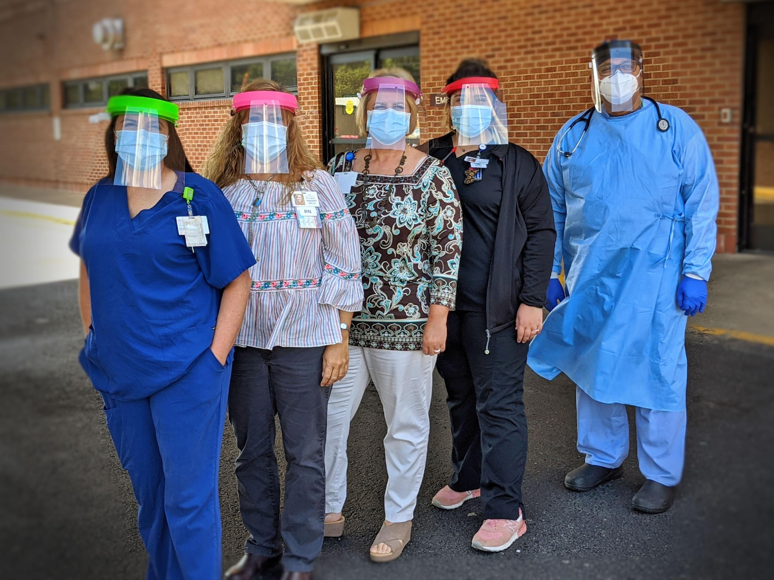
Community Collaboration
COVID Donations
Great outpouring of support from community and business
Masks, PPE, supplies
Food for staff

Slide 3
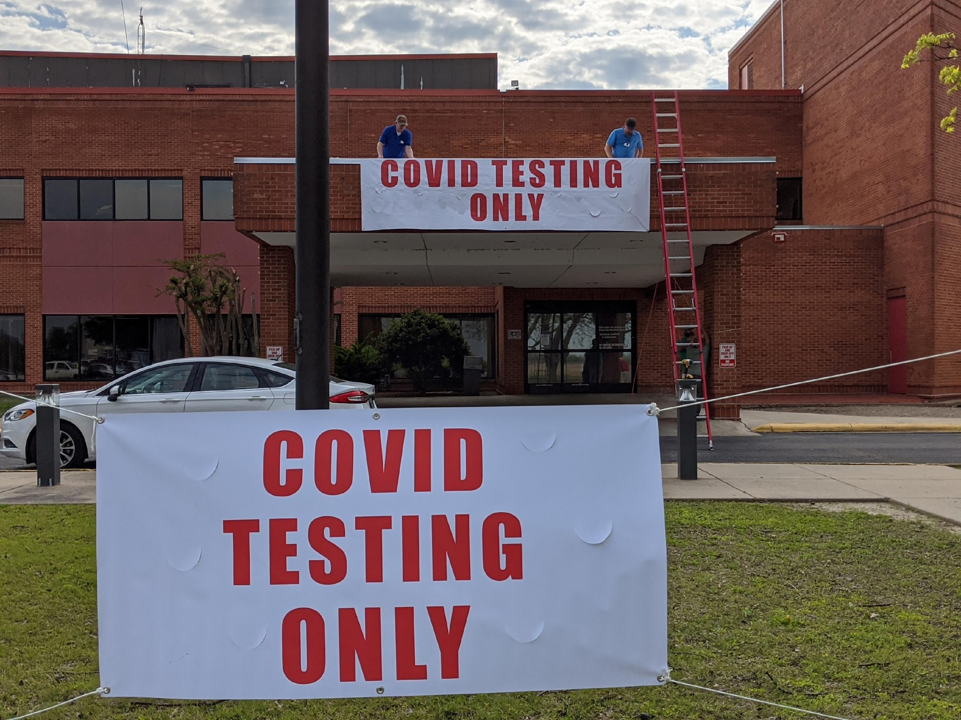
Community Collaboration
COVID Testing Centers
Dedicated entrance for testing
Curbside testing

Slide 4
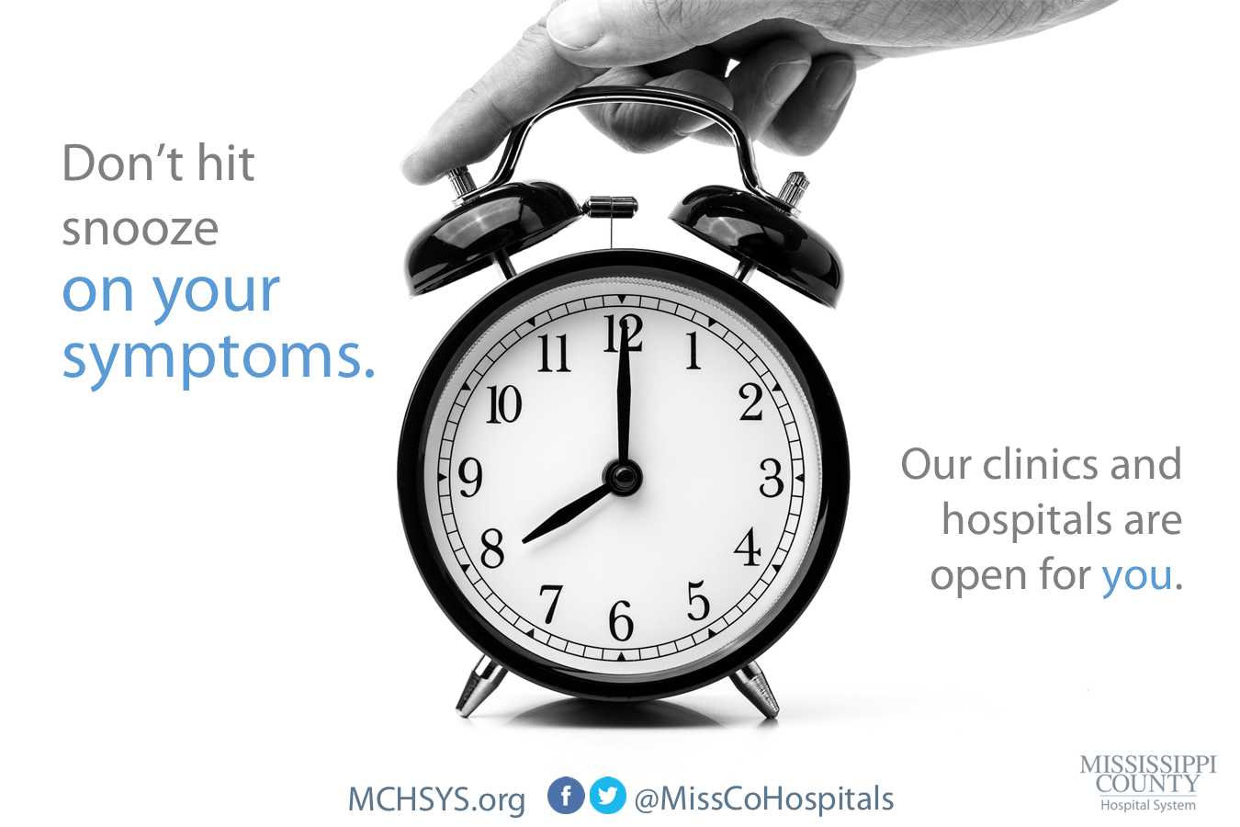
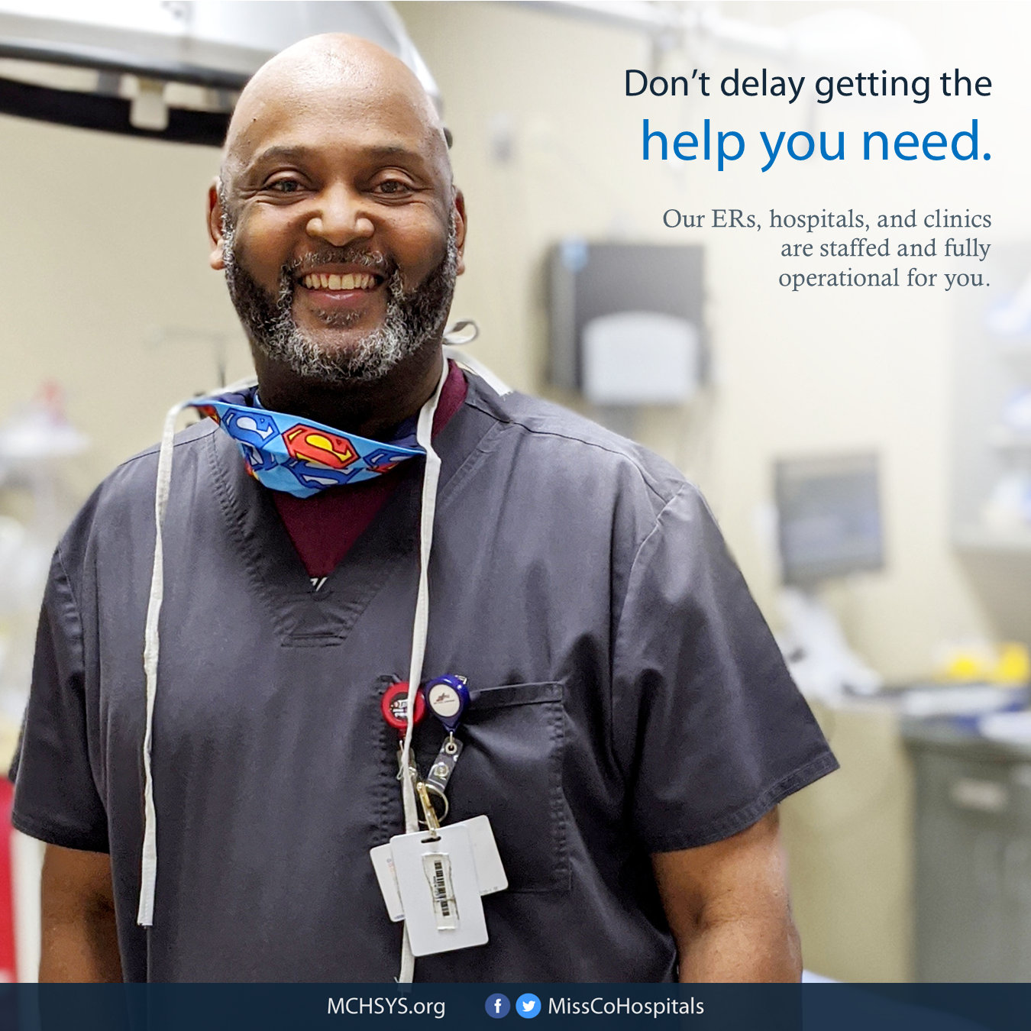
Community Collaboration
Education through Marketing
Importance of continued care despite COVID
Reassurance of safety
Utilization of newspaper and social media
Articles, advertisements, videos

Slide 5
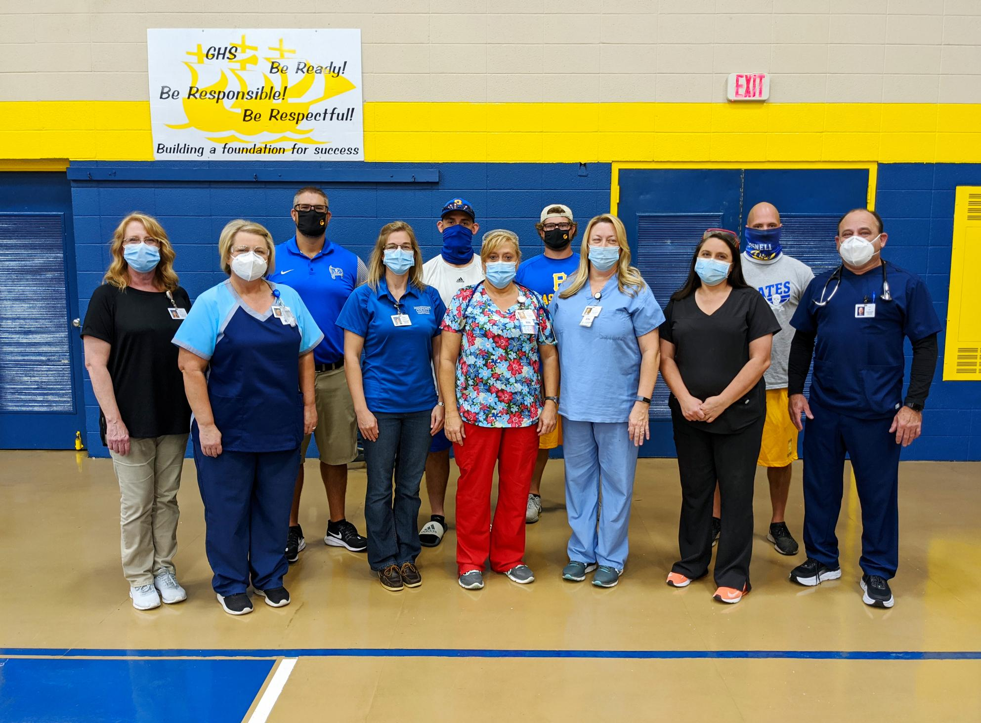
Community Collaboration
Continued plans with adjustments
School physicals with social distancing, spread out groups

Slide 6
Hospital COVID-19 Safety Measures
Limiting visitors
Directing all traffic through Emergency Room
Screening questions, temperature check
Increased sanitizing and cleaning procedures
Masking required for all employees when in shared space
Use of telehealth for primary care visits
Complying with CDC recommendations

Slide 7
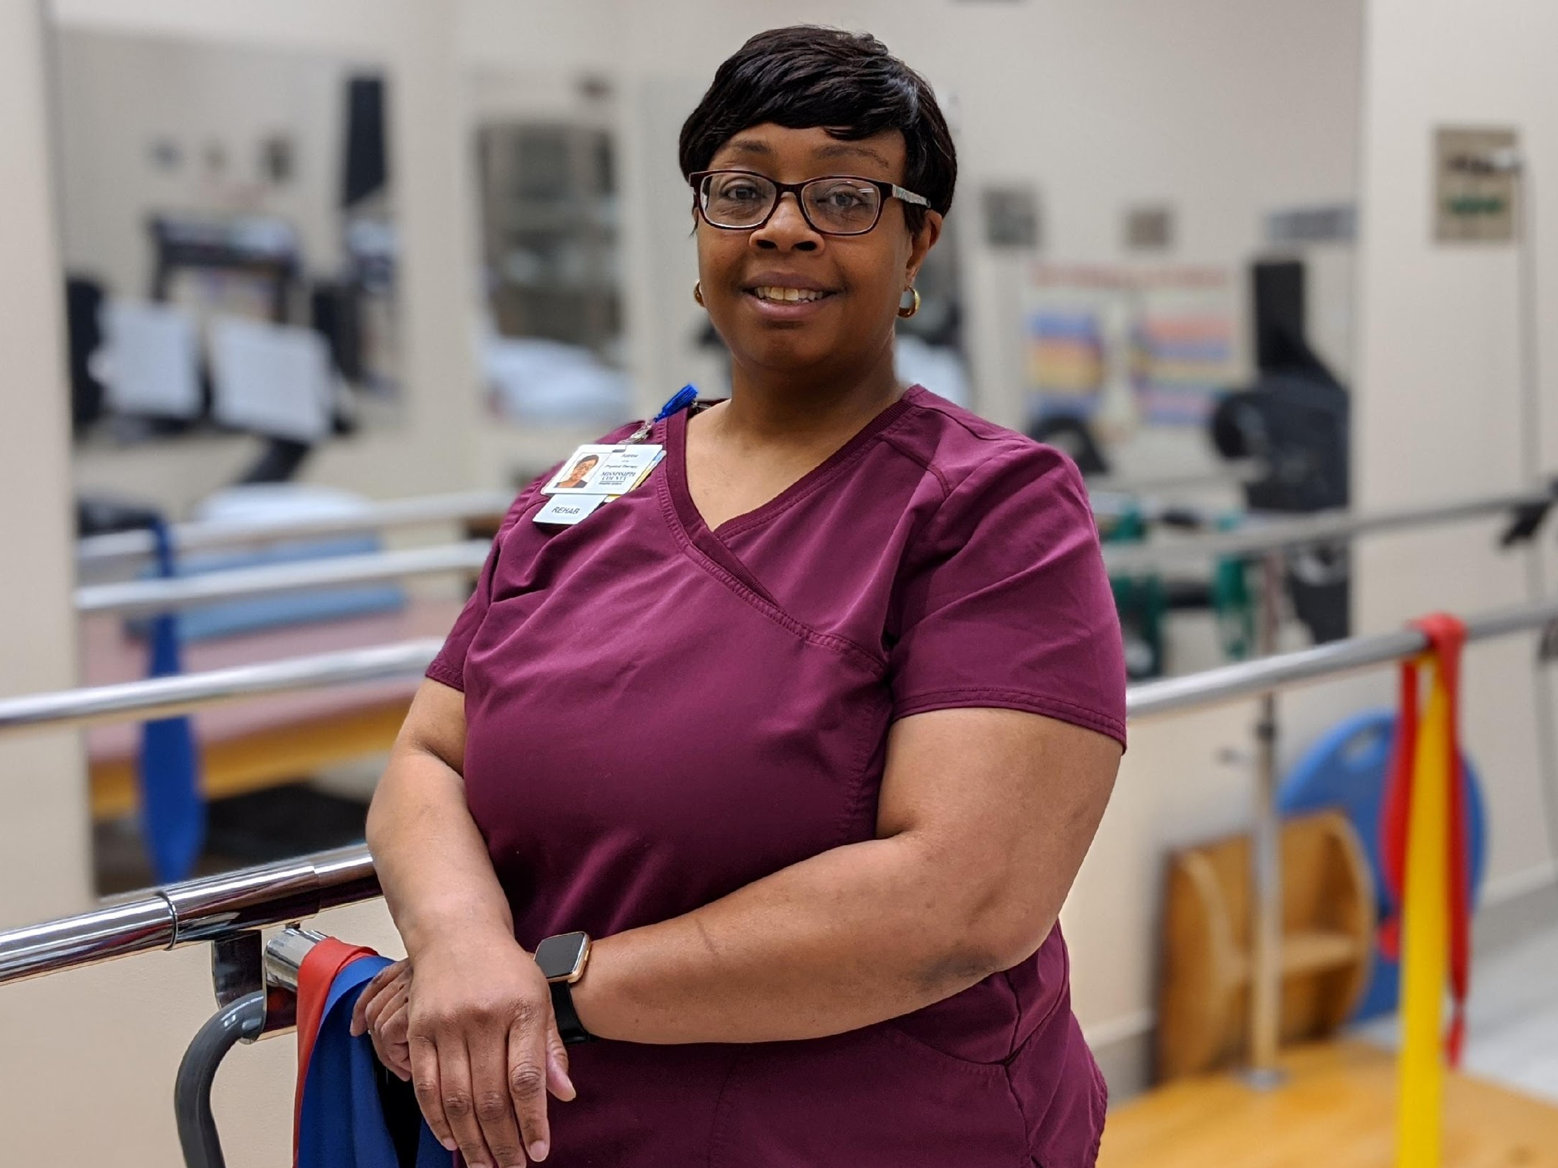
Current Services
Inpatient and Outpatient
Physical therapy
Preventive Care
Mammogram, MRI, CT scan, x-rays, laboratory,
Comprehensive Women’s Health Services
OB/GYN, labor & delivery

Slide 8
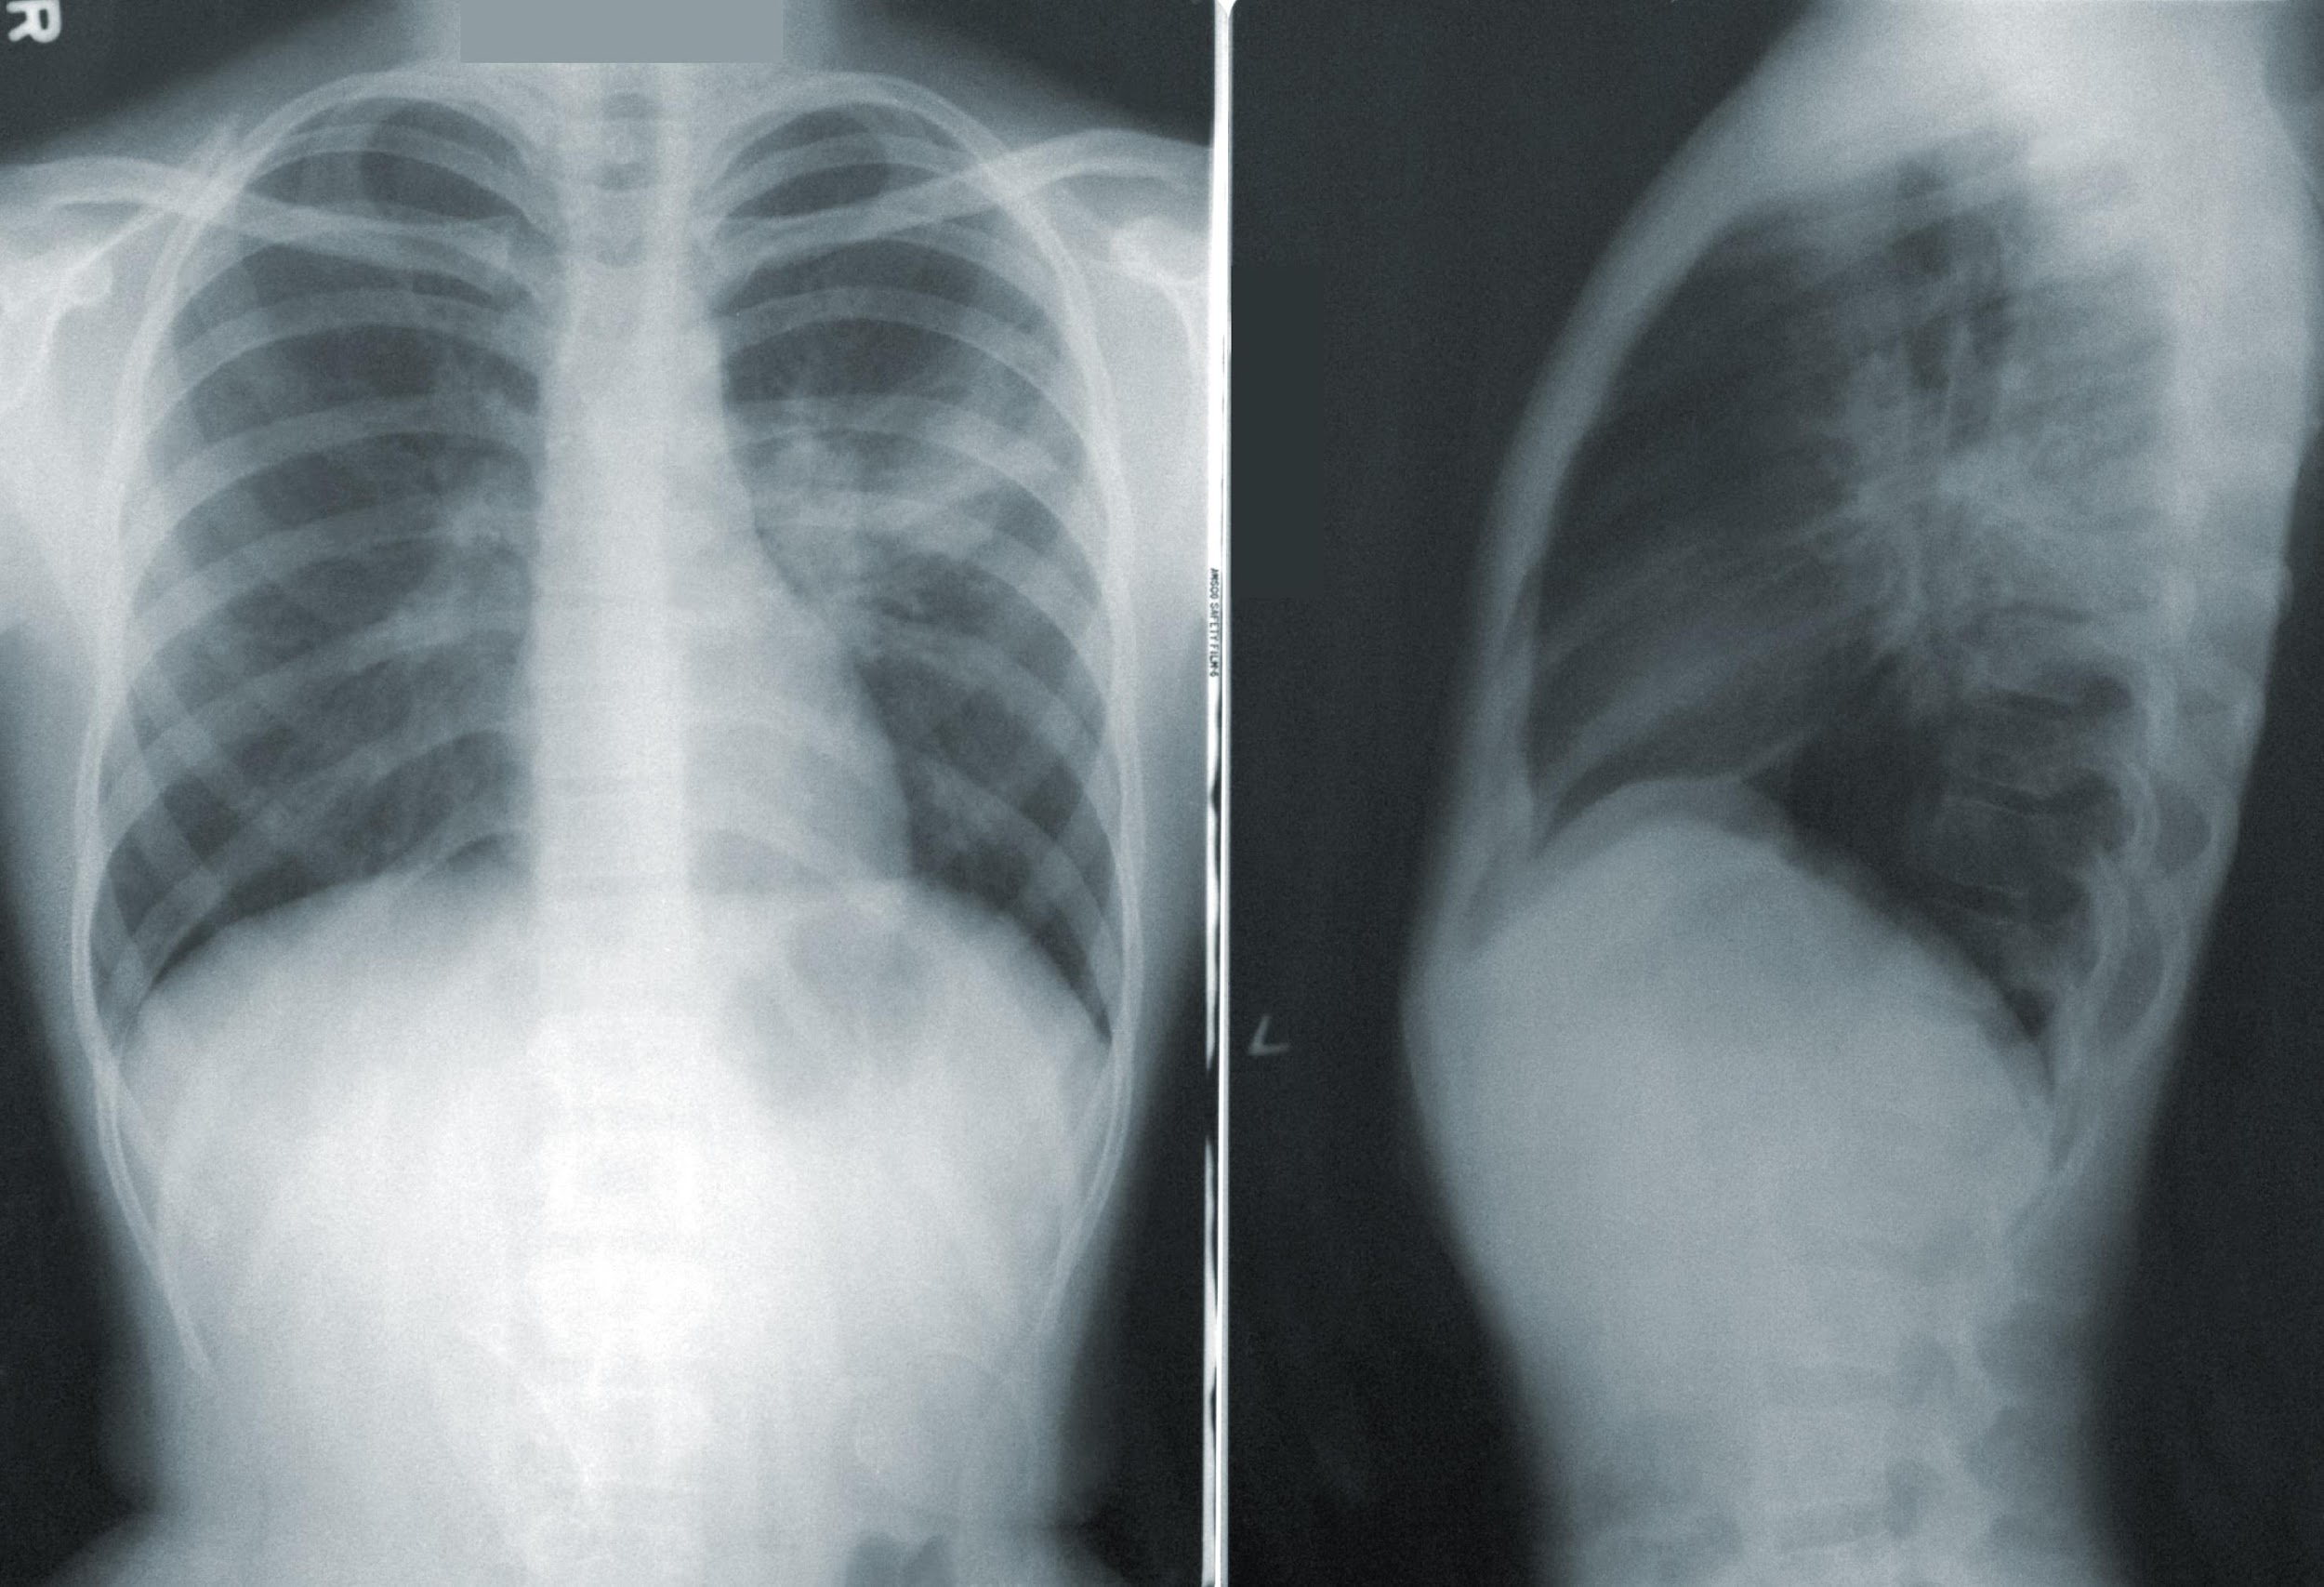
Current Services: Specialty Clinic
Specialty Clinic
Orthopedics
General Surgery

Slide 9
Emerging Services: Cancer Center
Cancer Center
Opening September 8
Oncology, Infusion, Hematology

Slide 10
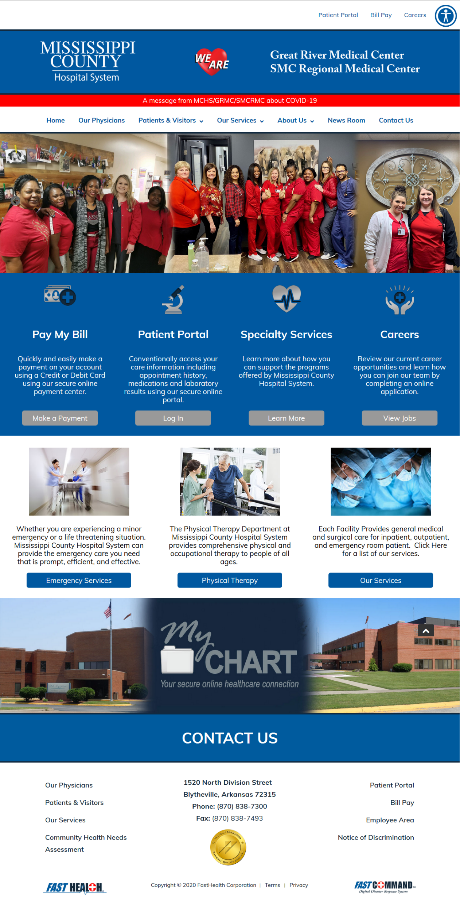
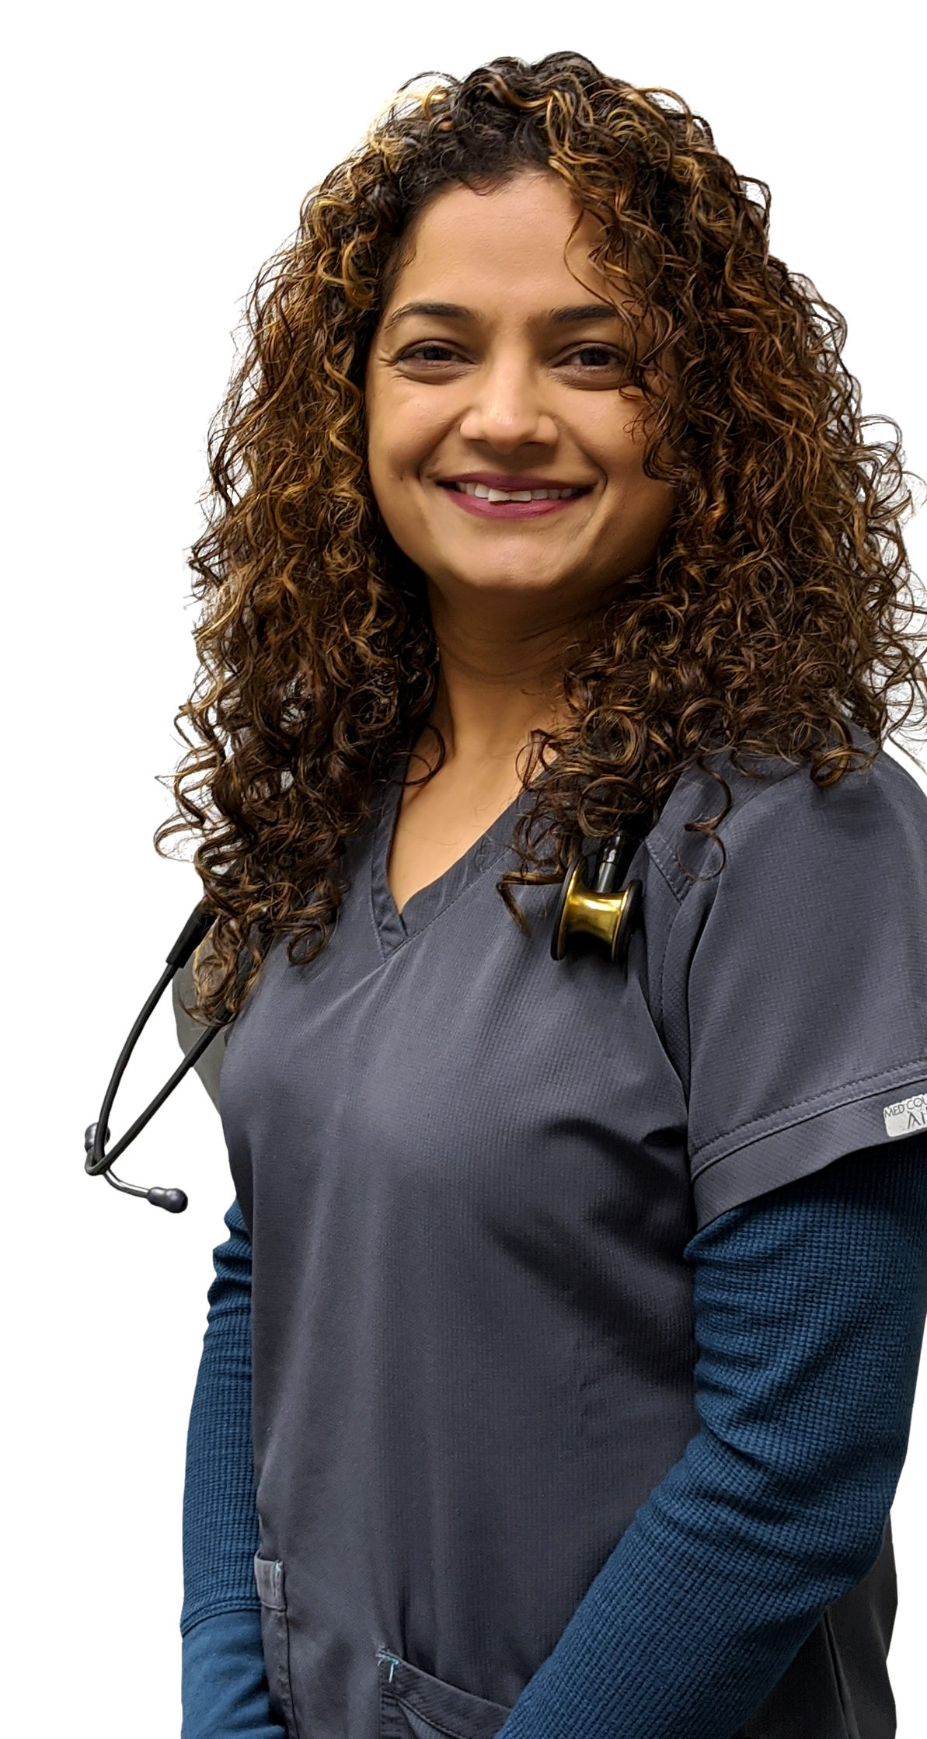
Emerging Services: Telemedicine
Telemedicine Upgrades
Computers, software

Slide 11
Community Collaboration
Started Tele health at the Family Medical Center
New Wellness Center opened with special safety measures during the pandemic
COVID hotline 24 hours a day offering testing services
Family Medical Center increased their clinic hours on Saturdays and are now open on Sundays as well
Nationwide prescription connection

Slide 12
Workforce Development
Ripple effect: For every dollar hospitals spend, an additional $1.40 is generated in spending in local economies for every hospital job 1.4 jobs are created in other sectors.
“Supporting your local hospital helps support our community’s local businesses – your decision for choosing local healthcare helps improve our community overall.”
Hospital gives out many scholarships every year to assist with different medical school students

