Slide 1
Delta Region Community Health Systems Development Program
Community Priority Action Planning Workshop Example Slides

Slide 2
Directions:
This is a compilation of slides from several of our Community Champions and actual CPAPWs.
Please use these to help you think creatively about your slides and what you want them to look like. Notice the consistent color pallets across slides used by different Community Champions. Note: we encourage you to use your health care organization branded colors or templates.
Share information from your community health status report and community health questionnaire and include a picture from your Community Connect Event with giving all your workshop participants a better understanding of the health of YOUR community.

Slide 3
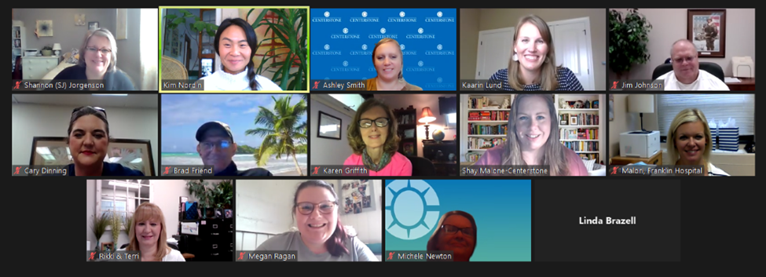
Community Connect Event Recap
The event began with a presentation on community collaboration during the pandemic, as well as current and emerging services at Franklin Hospital.
Small groups included conversations surrounding:
How the pandemic is affecting you, your organization and community?
What you would like to see coming out of the pandemic for your family, organization, and community?
How can the hospital help the community to see an impact?
What are you as a community member willing to help with?

Slide 5
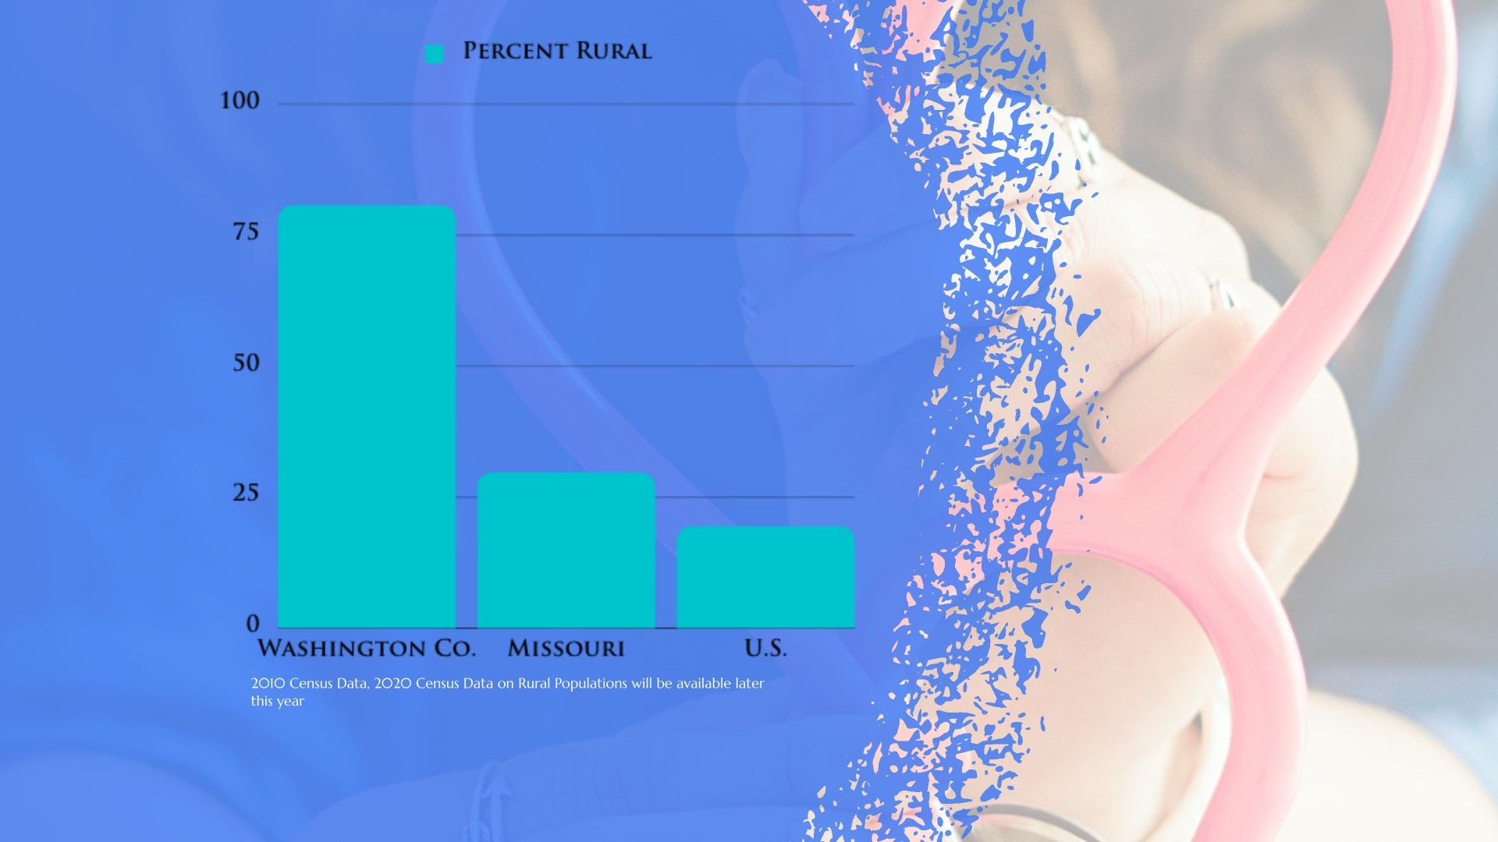
Notes:
TR

Slide 6
Notes:
TR

Slide 7
Notes:
TR

Slide 8
Notes:
Kelly

Slide 9
Notes:
Kelly

Slide 10
Notes:
Kelly

Slide 11
Notes:
Kelly

Slide 12
Notes:
Kelly

Slide 13
Healthcare Accounts for 20% of Health
Health Behaviors – 30%
Tobacco Use
Clinical Care – 20%
Access to Care
Social & Economic Factors – 40%
Education
Diet & Exercise
Alcohol & Drug Use
Sexual Activity
Quality of Care
Employment
Income
Family & Social Support
Community Safety
Physical Environment – 10%
Air & Water Quality
Housing & Transit
Notes:
Many factors shape our opportunities to be healthy and influence how well and how long we live. Health factors represent the things we can change to improve health for all, like opportunities for quality education, good paying jobs, access to quality clinics care, healthy foods, green spaces, and secure and affordable housing. We measure four health factor areas:
Health Behaviors
Clinics Care
Social & Economic Factors
Physical Environment
Let’s take a quick look at these factors based on our own county’s statistics….

Slide 14
Social Determinants of Health
Neighborhood & Built Environment
Health & Healthcare
Social & Community Context
Education
Economic Stability
Healthypeople.gov
Notes:
Health starts in our homes, schools workplaces, neighborhoods and communities. We know that taking care of ourselves by eating well and staying active, not smoking, getting the recommended immunizations and screening tests, and seeing a doctor when we are sick all influence our health. Our health is also determined in part by access to social and economic opportunities; the resources and supports available in our homes, neighborhoods and communities; the quality of our schooling; the safety of our workplaces; the cleanliness of our water, food and air; and the nature of our social interactions and relationships. The conditions in which we live explain in part why some of us are healthier than others and why some of us are not as healthy as we could be.

Slide 15
Demographics
 | Randolph County | Illinois | Nation
Population | 32,423 | 12,802,023 | 327,167,434
% Rural Population | 42.6% | 11.5% | 19.3%
Population Age 65+ | 18.2% | 15.2% | 15.6%
Population Change | -4.1% | -0.7% | 6%
Veteran Population | 2,365 | 614,725 | 18,939,219
Disabled Population | 10.4% | 71.% | 8.7%
Demographic and Social & Economic Data from United States Census Bureau
County, State, and National Demographic Data from County Health Rankings & Roadmaps
Notes:
The population in Randolph County has decreased by about four percent since 2010. Randolph county has a higher percentage of disabled population than the state and national averages (10.4% compared to IL 7.1% and nationally 8.7%). Fourty-two percent of the population of the county lives in an area designated as ‘rural’ compared to Illinois, 11.5% and Nation, 19.3%. Eighteen percent of its residents are over 65 years old and ten percent are disabled and under 65 years old. County, State, and National

Slide 16
Social & Economic Factors
 | Randolph County | Illinois | TOP US Performers
High School Graduate or Higher, percent of persons age 25+ | 87% | 87% | 96%
Some College | 48% | 69% | 73%
Median Household Income | $52,700 | $63,000 | $67,652
Per Capital Income in las 12 months | $24,715 | $32,924 | $31,177
Public Health Insurance Coverage Alone | 19.8% | 20.2% | 19.6%
Unemployment Rates | 4.3% | 5.0% | 2.6%
Children in single-parent households | 34% | 34% | 20%
Children eligible for free or reduced lunch | 49% | 50% | 32%
Persons below 150% Federal Poverty Level | 6,763 | 2,7650,295 | 74,202,606
County, State, and Top U.S. Performers Social & Economic Factors data from County Health Rankings & Roadmaps.
United States Census Bureau American FactFinder.
County, state and national data from American FactFinder.
Notes:
Randolph County’s per capital income is lower than the state and Top U.S. Performers.
We have about the same percentage of the population receiving public health insurance alone, children eligible for free and reduced lunch, and similar unemployment rates to the state of Illinois.
Randolph County has a fair high school graduation rate, but a lower than average percentage of the population with some college compared totehs tate, and Top U.S. Performers.
The 150% Federal Poverty level measures annual cash income for an individual or family. These numbers show the people eligible for program, subsidies, and benefits like SNAP, Head Start, Children’s Health Insurance Program, and the National School Lunch Program.

Slide 17
Health Behaviors
 | Randolph County | Illinois | TOP US Performers
Adult Smoking | 17% | 16% | 14%
Physical Inactivity | 25% | 22% | 19%
Drug Overdose per 100,000 | 17 | 18 | 10
Excessive Drinking | 21% | 21% | 13%
Poor or Fair Health | 16% | 17% | 12%
Teen Births per 1,000 females aged 15-19 | 32 | 23 | 14
Obese Adults > age 20 BMI > 30 | 28% | 29% | 26%
Alcohol Impaired Driving | 29% | 33% | 13%
Poor Mental Health Days reported in the last 30 days | 3.5 | 3.5 | 3.1
County, State, and Top U.S. Performers Health Outcomes data from County Health Rankings & Roadmaps.
Notes:
Randolph County ranked 46out of 102 counties in Illinois for health behaviors. Health behaviors, such as physical activity and eating healthy foods, can lead to positive health outcomes such as longer life, mobility, mental wellness, healthy pregnancies and births, prevention of chronic and acute disease, and management of chronic disease. Socially isolated individuals have an increased risk for poor health outcomes, including chronic disease, unhealthy behaviors and obesity.
The use of cigarettes, lack of physical activity, dietary choices and other elements can lead to numerous chronic diseases and comorbidities including cardiovascular diseases diabetes and cancer. In Randolph County, alcohol impaired driving is 29% which is similar rate to Illinois, 33% , but higher than top U.S. Performers, 13%. This results in more unintentional injuries and higher mortality rates. Additionally, the relates of people who regard themselves as having poor or fair health is 16% in Randolph County, 17% in Illinois and 12% Top U.S. Performers. This measures relates to quality of life and describes how healthy people are while alive. People who rate themselves as “poor or fair health” have a twofold higher mortality risk than persons with “excellent” health.

Slide 18
Clinical Care
Fig.1. Primary care physicians in Randolph County, IL County, State, and National Trends, 2010-2016. Graph from County Health Rankings, Randolph County, IL. Retrieved from https://www.countyhealthrankings.org/app/illinois/2019/rankings/randolph/county/outcomes/overall/snapshot
Notes:
The graph below shows in another way, that Randolph County has had a shortage of primary care physicians compared to the state of IL going back to at least 2010. Availability of primary care physicians and dentists is essential for individuals to receive preventative care and referrals to appropriate specialty care.

Slide 19
Health Outcomes
 | Randolph County | Illinois | Nation
Life Expectancy | 77.6 | 79.3 | 81.0
Premature Age-Adjusted Mortality | 370 | 330 | 280
Infant Mortality per 1,000 in one year | n/a | 6 | 4
Diabetes Prevalence | 10% | 9% | 9%
Injury Deaths per 100,000 | 102 | 59 | 57
County, State, and Top U.S. Performers Health Behaviors data from County Health Rankings & Roadmaps.
Notes:
Randolph county is ranked 43 out of 102 for health outcomes. Life expectancy is lower in Randolph County, 77.6 compared to the state of Illinois, 79.3 and Top U.S. Performers, 81.0. This measure is easier to understand than years of potential life lost and is an important population health outcome measure. The Injury rate in Randolph County is 102 per 100,000 people, which is almost double the state of Illinois, 59 per 100,000 people, and Top U.S. Performers, 57 per 100,000 people. Injury deaths are an important measure because injuries are one of the leading causes of death of those under 45 years old. Poisoning, motor vehicle deaths, and falls are included under unintentional injuries and suicides and homicides fall under intentional injuries. Injuries are also a significant portion of emergency department visits.

Slide 20
Community Health Questionnaire Results
Notes:
When asked what the three most pressing concerns in the community impact health, mental health services ranked highest on the list (51.22%). Of the respondents, 31.49% ranked financial struggles as impacting health. Substance abuse services for smoking, vaping, illicit drugs and alcohol was also ranked as an impact (31.49%).
This interestingly fell in line with what the respondents identified as the top three largest gaps in healthcare services in our community. Respondents listed mental health services (67.07%), substance abuse services (42.68%) and Services for low income (39.02%). Respondents also listed substance abuse education (62.2%) and mental health services (62.2%) as the top greatest health education needs in our community.

Slide 21
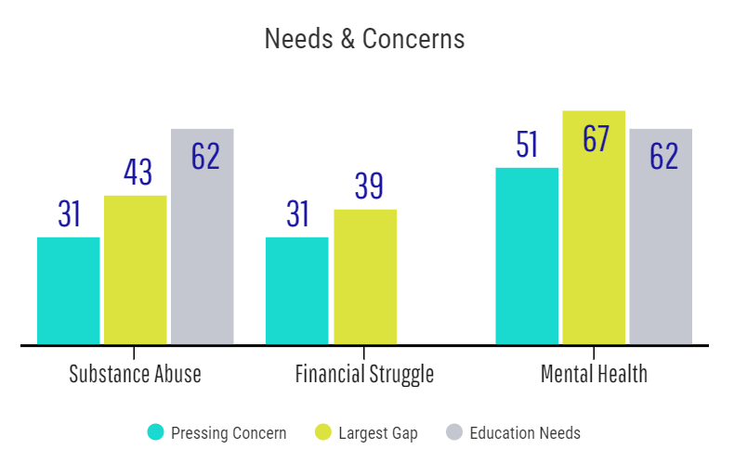
Needs & Concerns
Notes:
When asked what the three most pressing concerns in the community impact health, mental health services ranked highest on the list (51.22%). Of the respondents, 31.49% ranked financial struggles as impacting health. Substance abuse services for smoking, vaping, illicit drugs and alcohol was also ranked as an impact (31.49%).
This interestingly fell in line with what the respondents identified as the top three largest gaps in healthcare services in our community. Respondents listed mental health services (67.07%), substance abuse services (42.68%) and Services for low income (39.02%). Respondents also listed substance abuse education (62.2%) and mental health services (62.2%) as the top greatest health education needs in our community.

Slide 22
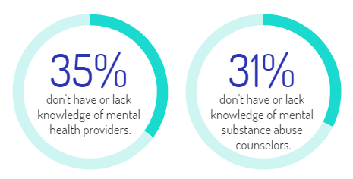
Access to Care
Notes:
This is compared to only 27.16% of the respondents who had a mental health care specialist that they could go to, while 35.8% responded that they did not have one, nor did they know where to go for services. Similarly, 31.25% of the respondents indicated that they did not have or know where to find a substance abuse counselor.

Slide 23
Access to Care
Notes:
When asked if there were any difficulties in getting needing prescriptions, 11% respondents ‘yes’ listing financial concerns as the reasoning.

Slide 24
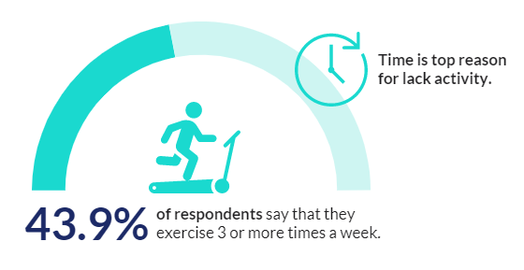
Physical Activity
Notes:
Just under half of the respondents exercise or participate in physical activity three or more times a week (43.9%). This leaves over half of the respondents not participating in physical activity for a variety of reasons, with simply choosing not to as the leading cause (25%).
When asked for reasons why they were unable to participate in physical activities and/or exercise on a regular basis, respondents listed time constraints most frequently.

Slide 25
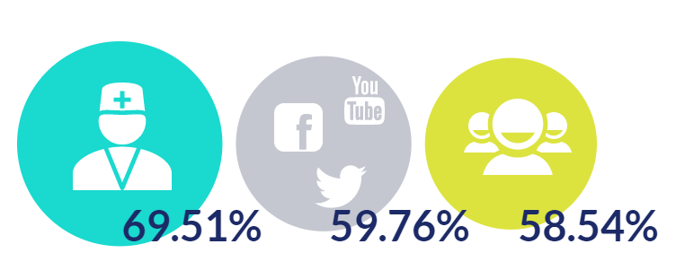
Source of Information
Notes:
The respondents of the survey listed their provider (69.51%) as the number one source of information on how to live a healthier lifestyle. Respondents also listed social media (59.76%) and friends/family (58.54%) as reliable sources of information.

Slide 26
Community Assessment Report Details cont.
What are the greatest health education needs in our community?
Top five answers included:
Preventive care and health screenings
Healthy lifestyle education
Mental health services
Substance abuse education
Oral/dental health education
Notes:
In order to improve the health of our community we have to better understand the needs that are currently of concern. The next survey question I want to bring your attention to is “what are the greatest health education needs in our community?” We know as community leaders and members that education is very important in our community. This gives us a chance to connect and build relationships with members of the community and also provides them knowledge that can empower them in their decision making skills. The top 5 answers from those surveyed were preventive care and health screenings, healthy lifestyle education, mental health services, substance abuse education, and oral/dental health education.

Slide 27
Community Assessment Report Details
Assessment Highlights
Three most pressing concerns impacting health in the community
Mental health services
Access to healthcare and other services
Chronic diseases (Ex. diabetes, COPD, cancer)
Notes:
Following our first virtual community connect event, we released a community health questionnaire to our community members. The survey was shared via email to community joint partners and all employees of Franklin Hospital, as well as on social media. The survey highlighted topics such as community health concerns, preventive healthcare, access to various healthcare services, as well as knowledge and interest of telehealth services. We received 17 responses to the survey.
One of the survey question worth highlighting asked the community what the three most pressing concerns impacting health in our community. The three most popular answers were mental health services, access to healthcare, and other services.

Slide 28
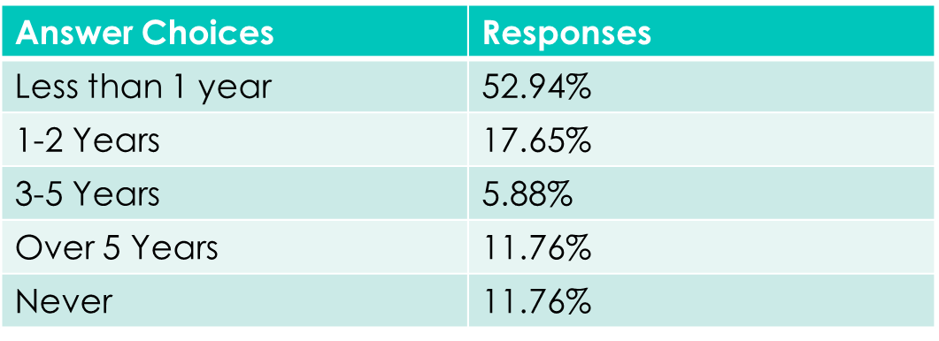
Community Assessment Report Details
Assessment Highlights Cont.
Preventive Care
Annual wellness checkups
Screenings
How long has it been since you received a routine checkup?
Notes:
Another question asked was how long has it been since you received a routine checkup? This was a great questions in terms of what preventative care looks like during the pandemic. We know as a hospital that during the pandemic it has been difficult to get patients in for their regular annual wellness checkups and preventative screenings. These visits are so important because a simple wellness visit and preventative screenings can improve health outcomes for the patients in our community.
Based on the survey question answers, 52.94% stated that it had been less than a year since their last routine checkup. 17.65% said 1-2 years, 5.88% said 3-5 years, 11.76 stated it had been over 5 years, and 11.76% said that they had never received a routine checkup.

Slide 29
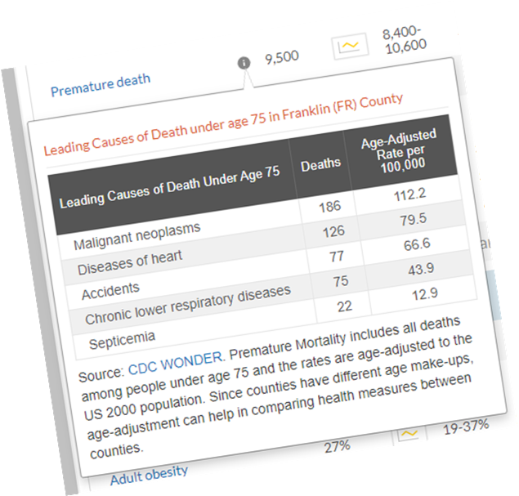
County Health Rankings 2016 - 2018
38,701 – Population of Franklin County
Approximately 750 premature deaths in reporting period
Cancer 25%
Heart Disease 17%
Accidents 10.4%
Chronic Low Respiratory Disease 10.1%
Septicemia – 3%
Notes:
While gaining an understanding of the needs from community perspectives is important, it is also important to understand what our community looks like statistically when it comes to our health outcomes and behaviors.
Based on county health rankings reporting from 2016-2018, Franklin County has a population of 38,701.
There were approximately 750 premature deaths during this reporting period. Premature deaths are categorized by any death before the age of 75.
Just to break that down a little bit further, that would equal 1.9% of our county population.
Out of those premature deaths, cancer made up 25%, heart disease at 17%, Accidents made up 10.4%, Chronic Low Respiratory Disease made up 10.1%, and septicemia made up 3%.
Out of 102 counties in Illinois, Franklin County is ranked 93rd in regards to premature deaths. Just to give you a comparison, the #1 county in Illinois is Monroe County. They have a population of 34,335 with 279 premature deaths. So a similar population but significant difference in premature deaths between us and them.

Slide 30
Community Health Questionnaire
SurveyMonkey questionnaire developed by Perry County Health System and National Rural Health Resource Center
Sent to all individuals invited to Community Connect Event on February 9, 2022
Asked individuals to forward to employees within their organizations to complete by February 23, 2022
WE RECEIVED 193 RESPONSES FROM THE COMMUNITY
Notes:
At this time, we want to take a look at the survey results from February 2022. All of you should have received a condensed version and access to the full version of the survey results. For today’s workshop, we are going to take a look at some of the responses that correlate with the previous data.

Slide 31
Community Health Questionnaire Key Results
(LARGEST HEALTH GAPS)
(Select 3 that apply)
Mental health services | 54.9%
Substance abuse services | 34.2%
Availability of services/providers | 33.1%
Services for low income | 28.5%
Prescription drug assistance | 22.8%
(GREATEST HEALTH EDUCATION NEEDS)
(Select 3 that apply)
Mental health services | 55.9%
Substance abuse education | 45.6%
Healthy lifestyles education | 43.0%
Obesity prevention | 43.0%
Preventive care and health screenings | 41.9%
Notes:
Other questions that we felt provided some correlation with previous results were the two listed on this slide. The top 2 areas on Health Gaps and Health Education Needs are the same.

Slide 32
What are the three most important reasons for selecting your healthcare organization?
(Select 3 that apply and/or enter other reasons not listed)
Closest to home | 45.6%
Cost of care | 43.0%
Required by insurance plan | 42.4%
Prior experience with hospital | 41.4%
Reputation for quality | 37.3%
Recommended by family or friends | 27.9%
Referred by physician | 22.2%
Closest to work | 12.9%
Other (please specify) | 5.1%
VA/Military requirement | 0.0%
PCHS offers 23 specialty providers locally.
Notes:
As you can see, the top 4 and possibly even top 5 reasons are quite comparable. This is important to us, Perry County Health System, as we strive to meet our Mission and Vision, and what makes this more important, is our ability to provide specialty care to our residents. It is my understanding that there are 35 critical access hospitals in the state of Missouri and we are at the top of list for providing specialty services locally.

Slide 33
Demographics
Projected population increase of 0.18% annually from 2016-2021.
The median age of the people of Natchitoches is 34.4 years due to the presence of Northwestern State University.
Large population living in rural area compared to the state and National average
 | Natchitoches | LA | Nation
Population | 40,323 | 4,766,833 | 323,580,626
Annual Pop. Growth (2016-21) | 0.18% | 0.77% | 0.84%
Median Age | 34.4 | 36.8 | 38.0
Pop Age 65+ | 14.75% | 13.25% | 14.1%
Population Living in Rural | 50% | 27% | 19.11%
Businesses | 1,696 | 199,110 | 13,207,211
Employees | 18,157 | 2,319,823 | 162,998,347

Slide 34
Health Behavior and Outcomes
Health behaviors can lead to positive health outcomes such:
Longer life
Physical mobility
Mental wellness
Healthy pregnancies and births
Chronic and acute disease prevention
Chronic disease management.
Natchitoches Parish ranked 41st out of 64 parishes in Louisiana for both Health Factors and Health Behavior.
Socially isolated individuals have an increased risk for poor health outcomes, including chronic disease, unhealthy behaviors and obesity
The use of cigarettes, lack of physical activity, and other elements can lead to numerous chronic diseases and comorbidities including cardiovascular disease, diabetes and cancer.

Slide 35
Health Behaviors
 | Natchitoches | LA | Nation
Access to Exercise opportunities | 57% | 75% | 77%
Physical Inactivity | 29% | 28% | 22%
Adult Smokers | 22% | 22% | 18%
Smokers with Quit Attempt in Past 12 Months | 65% | 60% | 60%
Low food access | 33% | 27% | 22%
Adults with Inadequate Fruit / Vegetable Consumption | 83% | 81% | 76%
Low access to exercise opportunities
Physical inactivity was higher in Natchitoches parish than the U.S . In a community survey, 34% of community member responded they never exercise or exercise once a while, 50% exercise regularly.
High percentage of Adult smokers.
Natchitoches County reports a high rates for poor access to food
83.3% of adults over the age of 18 are consuming less than 5 servings of fruits and vegetables each day.
Notes:
Obesity increase the risk of chronic diseases such as Diabetes, Kidney disease, Joint pain, hypertension , and heart disease.

Slide 36
Health Outcomes
 | Natchitoches | LA | Nation
Infant Mortality per 1,000 | 7.3 | 8.9 | 6.5
Coronary Heart Disease Mortality per 100,000 | 90.6 | 114 | 106
Cancer Mortality per 100,000 | 185 | 191 | 166.3
Premature Death <age 75 per 100,000 (age-adjusted) | 9,355 | 9,249 | 6,588
Unintentional (accident) Injury Mortality per 100,000 | 47.8 | 48.3 | 39
Obese Adults >age 20 BMI >30 | 35% | 34% | 28%
Adults with Diabetes | 12% | 11% | 9%
Adult High Blood Pressure | 36% | 34% | 28%
Medicare Population with Depression | 15% | 17% | 17%
Coronary Heart Disease: Lower than state and National average
Premature Death < age 75: higher than state and national average
Cancer Mortality: Higher than national average
Obesity: 35% of Natchitoches population is obese compared to the national average of 28% .
Diabetes: 12% adult with Diabetes higher than National average of 9%.
High Blood Pressure: 36% of adults have High Blood Pressure, which is higher than the national average of 28%.
15% of our Medicare population have depression

Slide 37
Access to Healthcare
 | Natchitoches | LA | Nation
Population Living in a Health Professional Shortage Area | 100% | 75% | 33%
Access to Primary Care Physicians per 100,000 | 59% | 79% | 88%
Preventable Hospital Stay | 67% | 68% | 50%
Uninsured Population | 14% | 9% | 8%
Population Receiving Medicaid | 32% | 26% | 21.23%
Cancer Screening – Mammograms | 56% | 62% | 63%
Hemoglobin A1c test – Diabetes Management (Medicare) | 86% | 83% | 85%
Pneumonia Vaccination age 65+ | 77% | 69% | 68%
100% of the population in Natchitoches Parish are living in a federally designated health professional shortage area. This shortage includes: primary care physicians, mental health providers and other medical specialist.
67% preventable hospital stay, which is more than the national average of 50%.
The Parish has a very high rate of people receiving Medicaid (32%)
Natchitoches is doing better than average with hemoglobin A1c testing and pneumonia vaccinations

