Slide 1
HRSA Data Collection Platform Webinar – FLEX Grantees
August 15, 2024
Notes:
Welcome to the HRSA Data Collection Platform webinar for the Medicare Hospital Flexibility (FLEX) grantees! My name is Katherine and I’ll be your facilitator today. I also have some of our project team to help with questions.
Today we’ll walk you through the new system, the HRSA Data Collection Platform. For some, completing the Performance Report may be brand new. And for others who have had grants previously, this new system is replacing the old EHBs PIMS, where you previously completed your Performance Reports.
We will walk through screenshots of the system and provide live demos throughout. Please note as we go through we have some test information that may look different than what you see. When you log into your account, you will only see the program and grant that you are associated with.
At the end, we’ll also answer your questions.
Throughout the presentation, please put your questions in the chat box and we will do our best to get through all the questions.

Slide 2

Agenda
Overview
Accessing the HRSA Data Collection Platform
Homepage Navigation
Completing and Submitting your Performance Report
Approval History and Approved Performance Reports
Change Requests
Grantee Raw Data Report
Q&A
Notes:
Our agenda for today:
First we’ll go over a quick overview of the change and who is affected.
Then we’ll look at how to access the new HRSA Data Collection Platform and how to navigate the homepage.
Next, and probably most important, how to complete and submit your performance report.
Then how to view the approval history and your approved reports.
Next, how to respond to change requests from HRSA.
And finally, how to access your Grantee Raw Data Report.

Slide 3
HRSA Data Collection Platform Transition Overview
Notes:
Let’s start with an overview of the transition

Slide 4
Overview
What is changing?
  New HRSA Data Collection Platform is replacing the EHBs Performance Improvement and Measurement System (PIMS) for Performance Reports
Why?
  New enhanced system provides a better user experience to complete and submit your Performance Report
Who is impacted?
  FLEX Program Grantees
When does this go into effect?
  All Performance Reports created on or after September 1, 2024
    Reporting period September 1, 2023 – August 31, 2024
Notes:
Before we get into the system details, let’s look at a little background on this transition.
As of September 1st, of this year, any performance reports created for FLEX Program grantees will be created and submitted in the new HRSA Data Collection Platform.
This new system has an updated look and feel, and is easier to navigate, to give you a better experience while completing and submitting your performance reports, than our previous performance reporting system.
As a reminder – this only applies to performance reports created on or after Reporting Period: September 1, 2023 – August 31, 2024
Submission Open Date: September 1, 2024
Report Due Date: October 30, 2024

Slide 5
Accessing the HRSA Data Collection Platform and Homepage Navigation
Notes:
Now, let’s look at how to access the system and navigate through the homepage

Slide 6
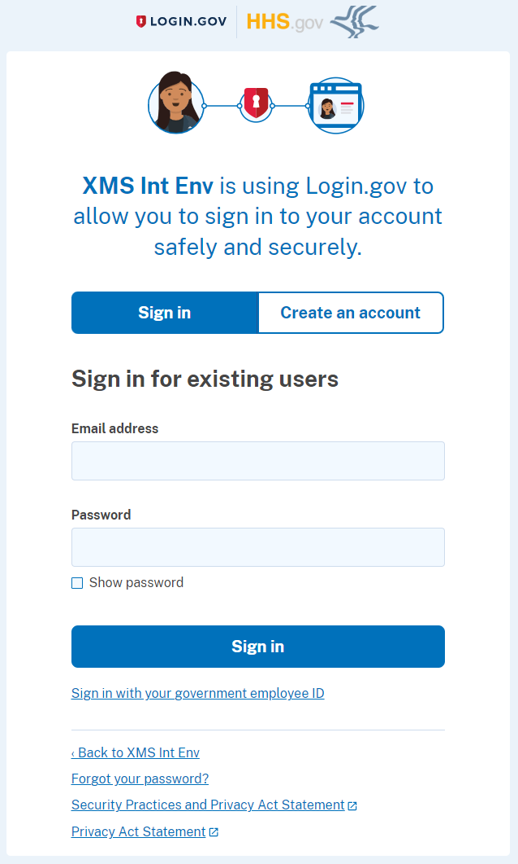
Accessing the Data Collection Platform
Login to https://hrsa-dcpaas.my.site.com/pars using Login.gov and two-factor authentication
  Use the same email address and password that was used for the EHBs Login.gov process
  If you do not have a Login.gov account set up for the EHBs, refer to the wiki help page to create an account
Notes:
Starting September 1st, use the link to the new HRSA Data Collection Platform. When your performance report is set up, you’ll receive an email with the link to the system.
While this is not a part of the HRSA EHBs, the systems are connected so you will still use your EHBs Login.gov email and password to complete 2 factor authentication to access the system.
If you do not have a login.gov account for the EHBs yet, please go ahead and create that. There are some HRSA wiki help pages to walk you through that process, linked through the slides.

Slide 7
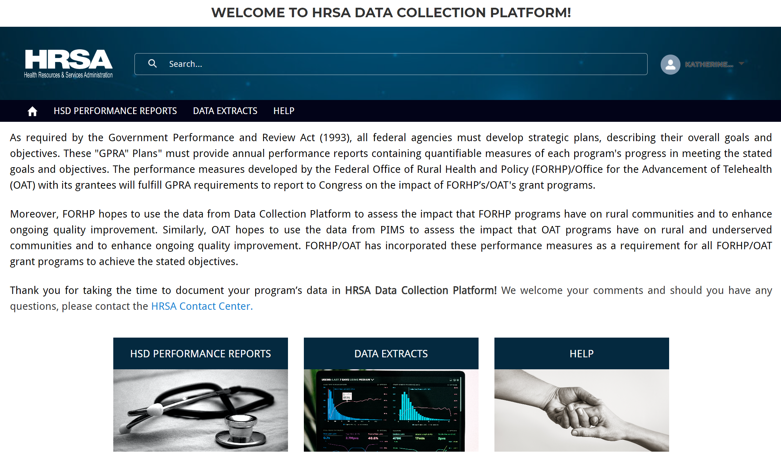
HRSA Data Collection Platform Homepage
View Grantee Raw Data Report
Username and Logout
View Help Page
View Performance Reports
Notes:
On the homepage:
Find your username on the top right side of the page. Once you click on your username, you’ll also see the log out option.
Select HSD Performance Reports to access your reports from the top tool bar or widget on the bottom
Select Data Extracts to access your Grantee Raw Data Report from the top tool bar or widget on the bottom
The middle section of the page contains background on the purpose for the performance report
And click Help to view the help pages

Slide 8
Completing and Submitting Performance Reports
Notes:
Now that you know how to access and navigate the system, let’s look at how to complete and submit your performance report

Slide 9
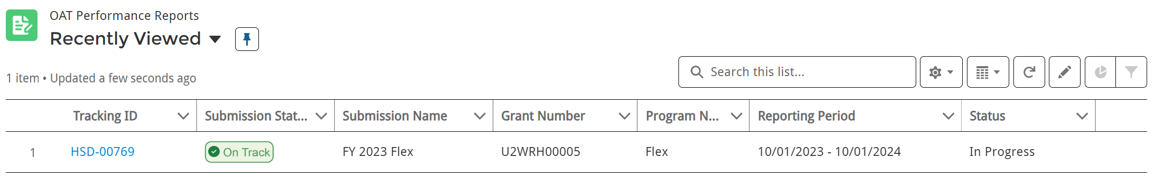
Performance Report List
Click to open Performance Report
Performance Report Status
Notes:
After selecting HSD Performance Report from the top navigation bar or widget on the bottom of the home page, you will see the performance report assigned to you. The list displays the Tracking ID, Submission Status (if applicable), Submission Name, Grant Number, Reporting Period, Program Name, and Status.
Click on the Tracking ID to open the Performance Report.
And view the status on the right side of the row

Slide 10
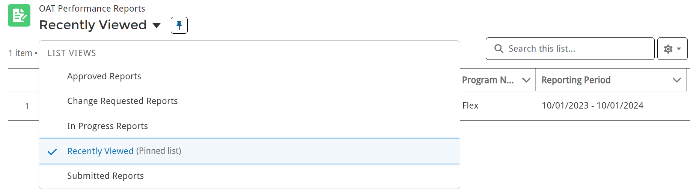
Performance Report List Views
Approved Reports: Received HRSA Project Officer (PO) approval; Approved status
Change Requested Reports: HRSA PO requested updates; Change Requested status
In Progress Reports: Grantee has not started or is still entering data; Not Started or In Progress status
Recently Viewed: Performance Reports viewed recently; can be any status
Submitted Reports: HRSA Grantee submitted the report, and it is being reviewed by the HRSA PO; Submitted status
Click to pin a default view
Search options
Click to change list view
Notes:
On the Performance Reports page, you can select different list views to find reports in different statuses.
The page defaults to Recently Viewed, but click the arrow next to Recently Viewed to select a different list view. You can also set a different view as the default using the pin.
Use the Search box to search for specific performance reports by tracking ID or status
The Approved Reports list view displays reports that the HRSA Project Officer has approved, and are in Approved status
Change Requested Reports list view displays reports the HRSA PO has returned for updates. They are in change requested status, and must be updated and resubmitted.
The In Progress Reports list view displays reports that have not been started or are in progress and have not been submitted. These are in Not Started or In Progress status.
Recently Viewed list view displays reports that you accessed recently.
And, Submitted list view display reports that have been submitted to HRSA for review, and have not been approved or change requested yet.

Slide 11
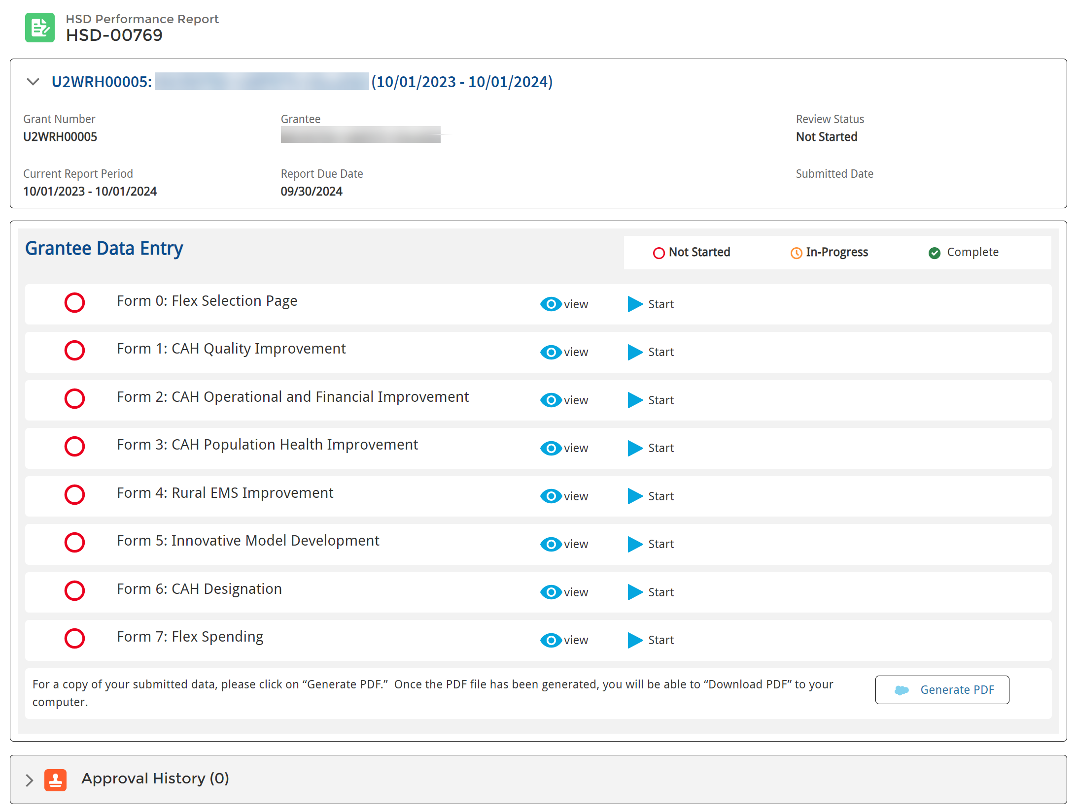
Performance Report Navigation
Tracking ID
Grant and Performance Report Details
Work on Performance Report
Performance Report Form Status
View read-only
View or Download Report PDF
Review and Approval Details
Notes:
After opening the performance report:
You can view the Tracking ID, details about the grant and performance report, including Submitted date and Review Status.
In the Grantee Data Entry section, you can see the status for each form – not started, in progress, or complete. Note, this is different than the status for the performance report at a whole.
Note: if you are having trouble seeing the status of a form, refresh your page or go back to the HSD Performance Report page and try opening the report again.
Select the View option to open a read only view of the form, or select Start (if the form is in Not Started status) or Edit (if the form is in In Progress status) to work on the report.
Select Generate PDF to view a PDF version of the entire report.
At the top of the page, when the report is ready, click Submit for Approval – which is only available once all forms are complete
Once submitted, you can track the Approval History at the bottom of the page.
Important! Before you can submit the performance report for approval, you must complete all forms.

Slide 12
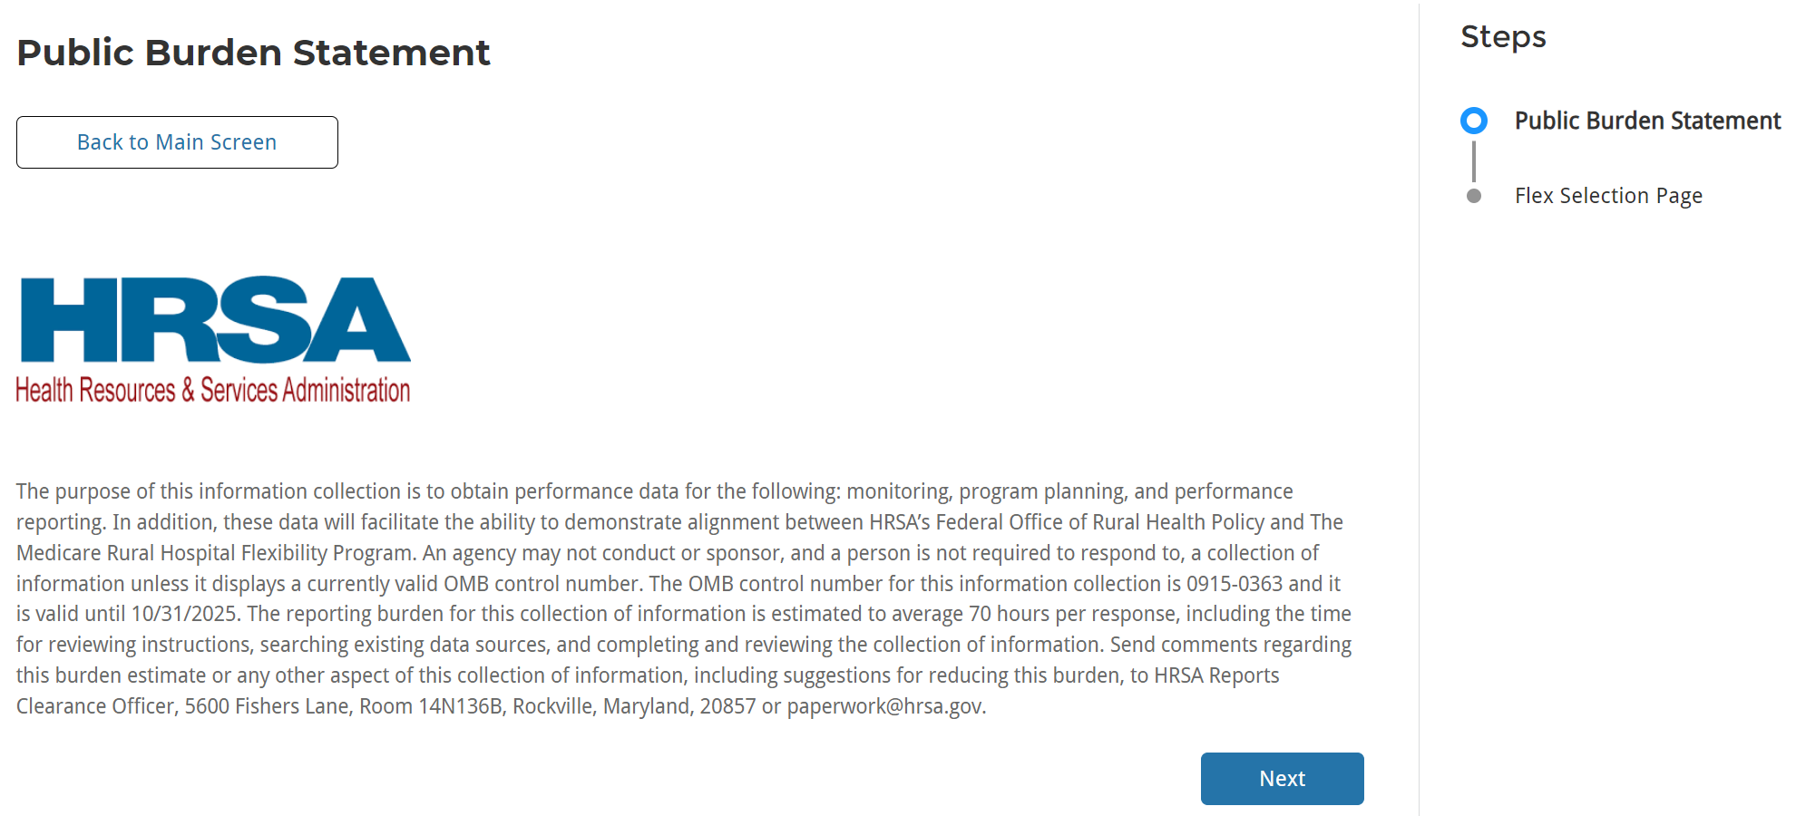
Public Burden Statement
Track Progress with Steps
Continue to Form
Notes:
After clicking Start or Edit to work on a form, the first page is the Public Burden Statement. Review the statement and click Next to continue to the data entry fields.
Throughout the form you can track your progress from the right side of the page with the Steps. They will turn green as you complete each step.

Slide 13
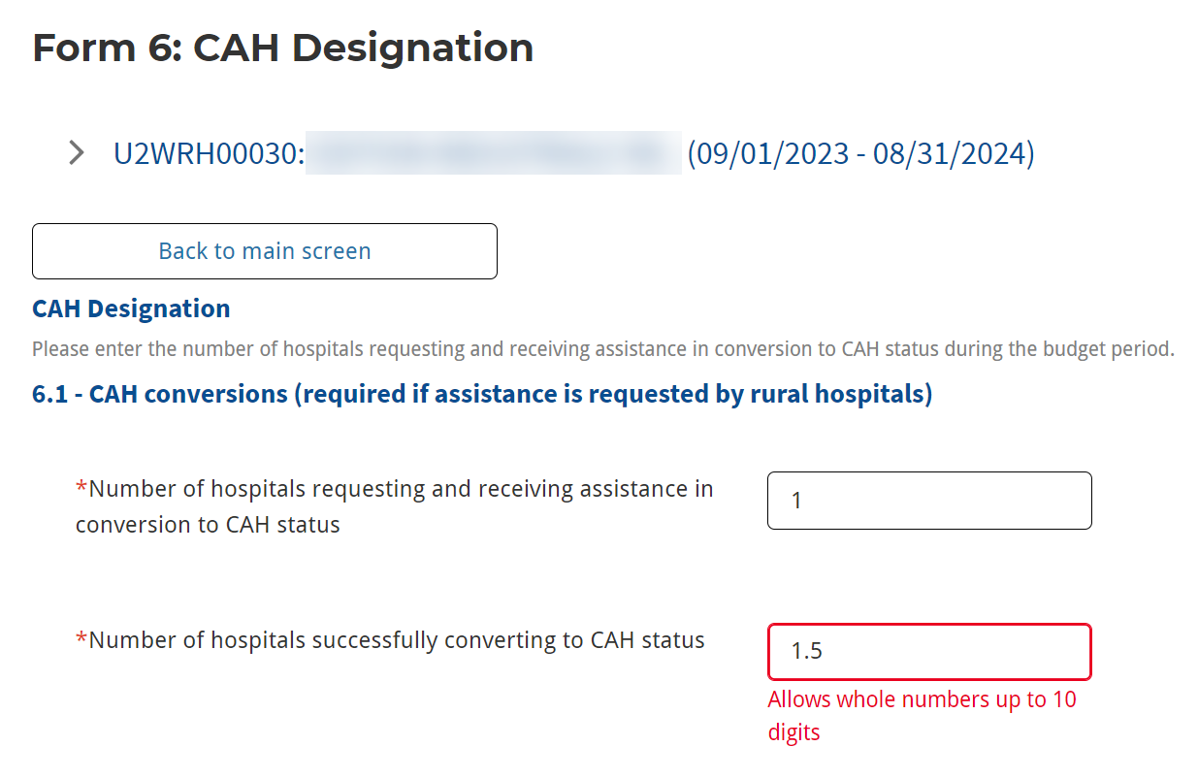
Form Data Entry
Required fields
Error to correct data type
Notes:
As you work through the form, be sure to complete all required fields, as indicated with an asterisk.
You can compare data to the previous reporting period, if applicable.
If an incorrect data type is entered, a required field is left blank, or dependent fields do not match, you will receive an error message to correct that data.
Some fields become required based on what you enter in dependent fields. If you enter data in a Value field, the corresponding Specify field becomes required

Slide 14
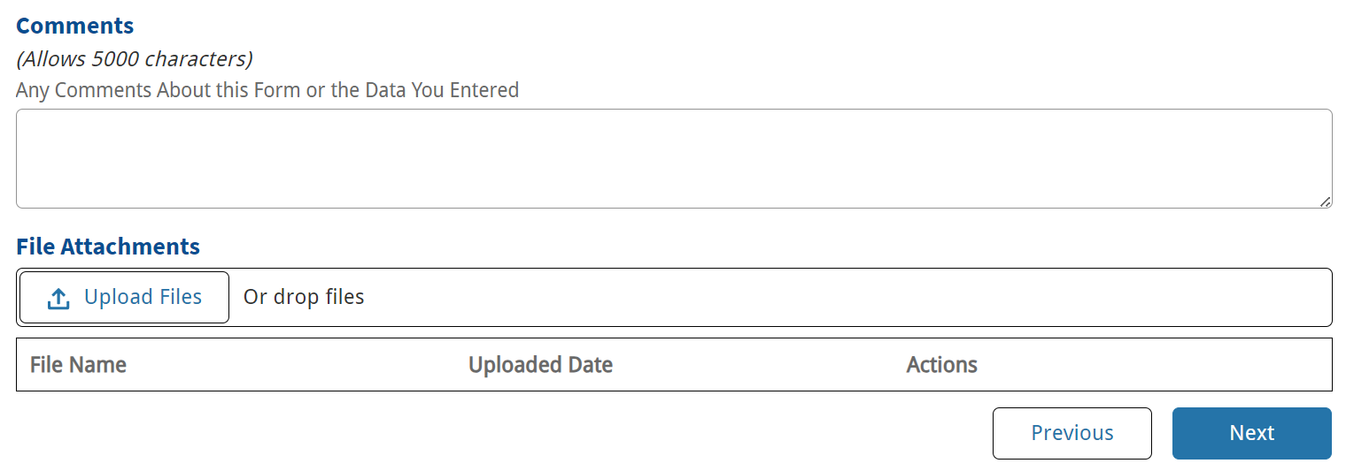
Comments and Attachments
Important!
If you click “Previous” or “Back to Main Screen” before clicking Next, your data from the current page will not be saved and may be lost!
Add optional Comments
Add optional Attachments
Click Next to Save data and move to next page
Notes:
At the bottom of the form, add any comments needed for the HRSA PO, or attach files. These are both optional fields. Take note that the comments and attachments show on each step of the form. File Attachments are not included in generated PDFs.
After completing the data on the step, click Next at the bottom of the page to save your data and go to the next step.
Take note that the Next button is how you save data on the page. If you click Previous, or Back to Main Screen, before clicking Next, your data will not save.

Slide 15
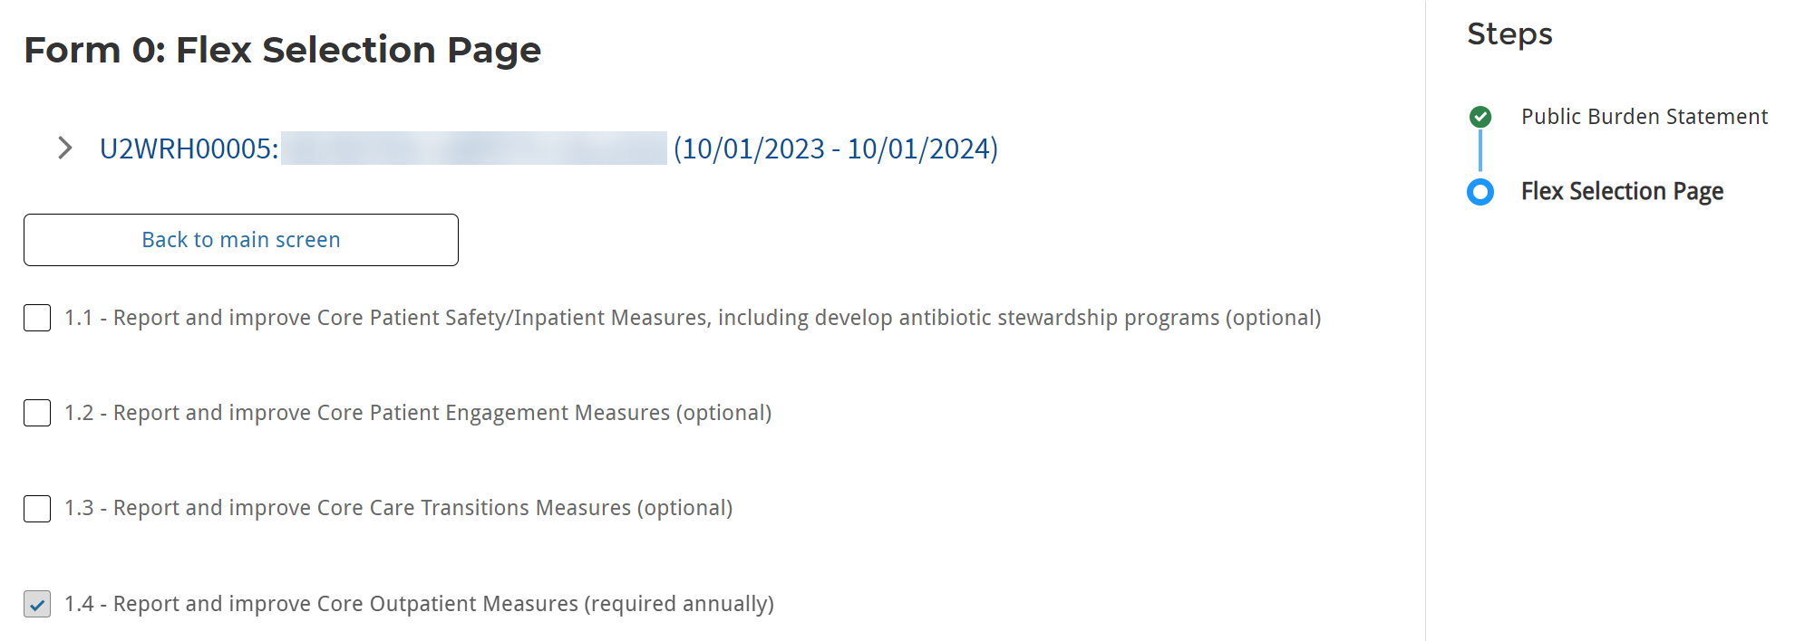
Example Questions: Flex Selection Page
Optional selections affect later forms
Notes:
On Form 0, select applicable optional options. Note: selections made affect later forms.

Slide 16
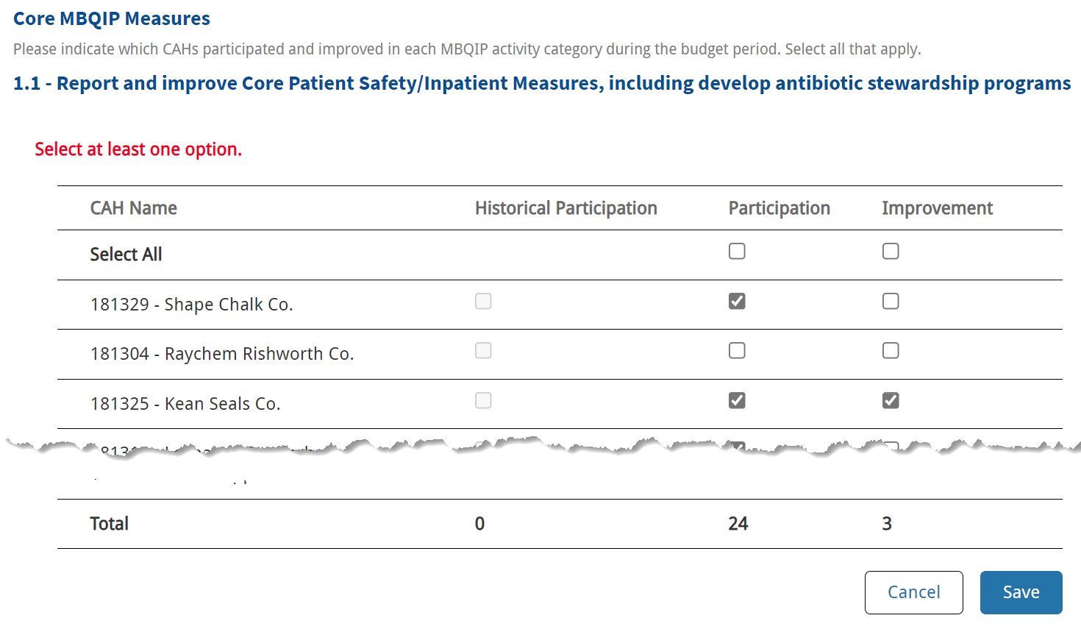
Example Questions: Activity Category Selection
Click to select all
Participation must be selected to select Improvement
Auto-calculated based on selections
Click Save before clicking Next
Notes:
On Form 1, in the Core Measures section, select CAHs that participated and improved in each activity category.
Click the box(es) in the Select All row to select all CAHs.
The CAH must be selected in the Participation column to select it in the Improvement column.
The Total row will auto-calculate based on the selections.
Once all selections have been made, click Save before clicking Next.

Slide 17
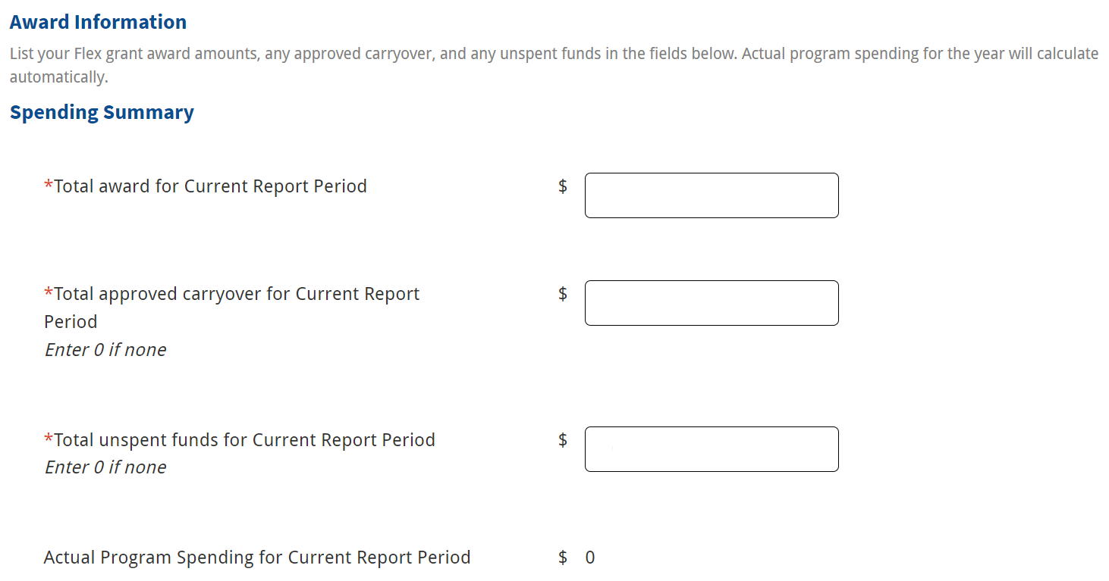
Example Questions: Flex Spending
Calculation auto-populates
Notes:
On Form 7, complete all required fields in the Spending Summary section. The Actual Program Spending for Current Report Period calculation auto-populates based on the information entered above.
Note: The Total Flex Funds Utilized calculation on Page 6 MUST match this calculation. However, this calculation is only available for reference on Page 1 of Form 7.

Slide 18
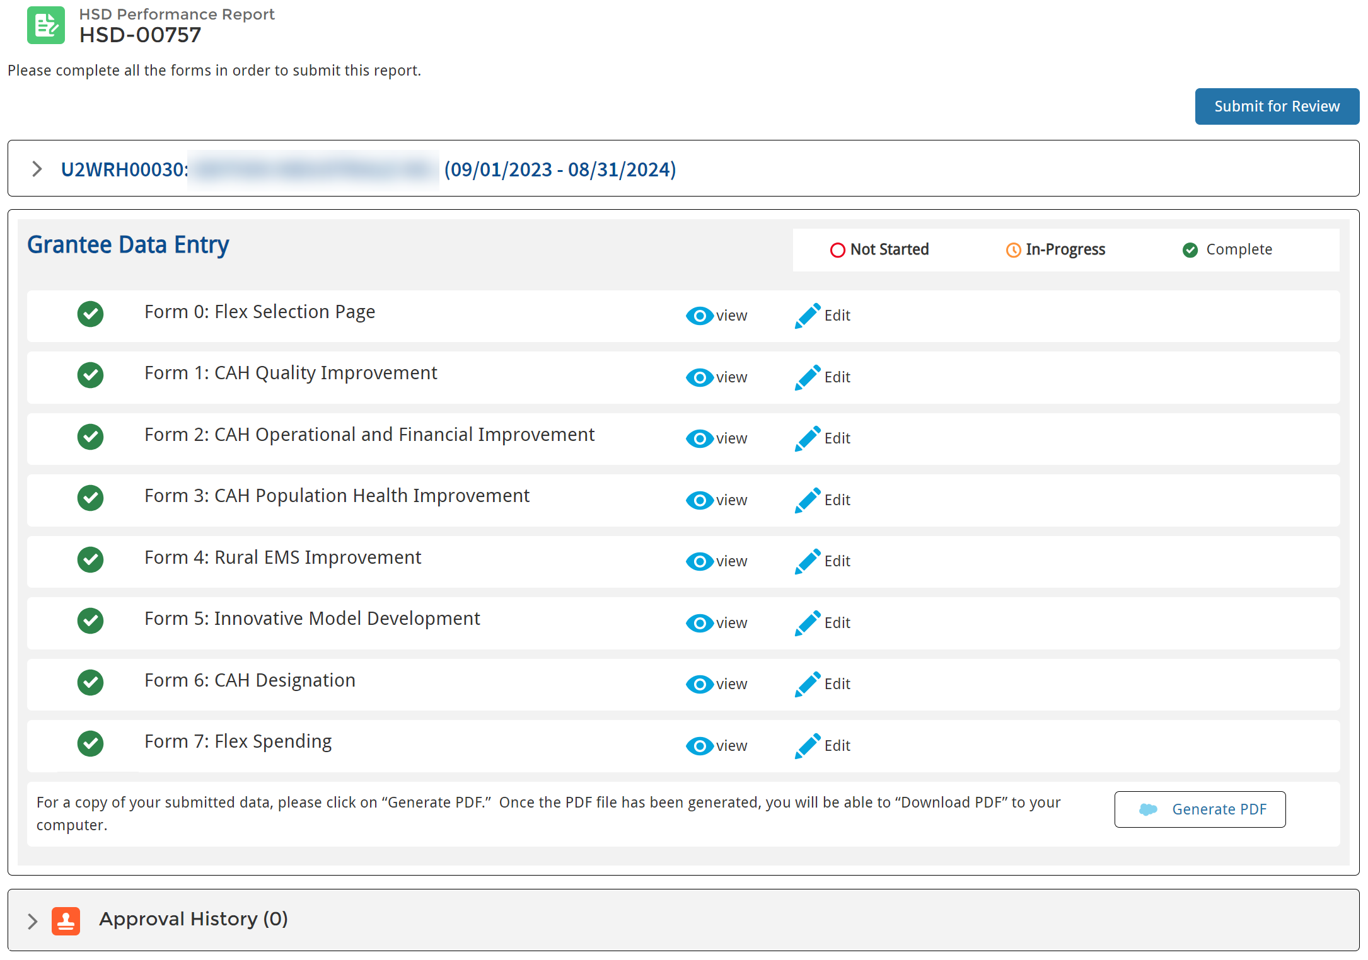
Submit Performance Report
Submit to HRSA PO
Forms in Complete status
Notes:
Once all required data is entered on the form, the form status updates to Complete. Complete all forms, and then you are ready to submit the report to HRSA for review.
Click the Submit for Review button on the top right of the page to submit the report.

Slide 19
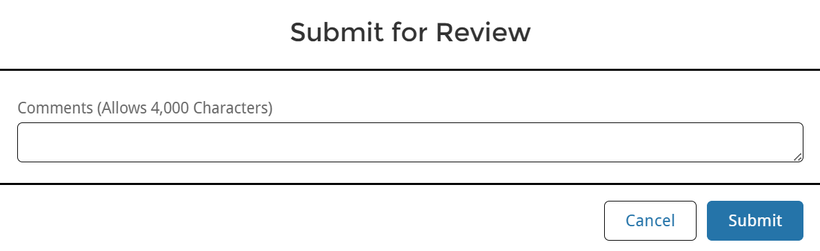
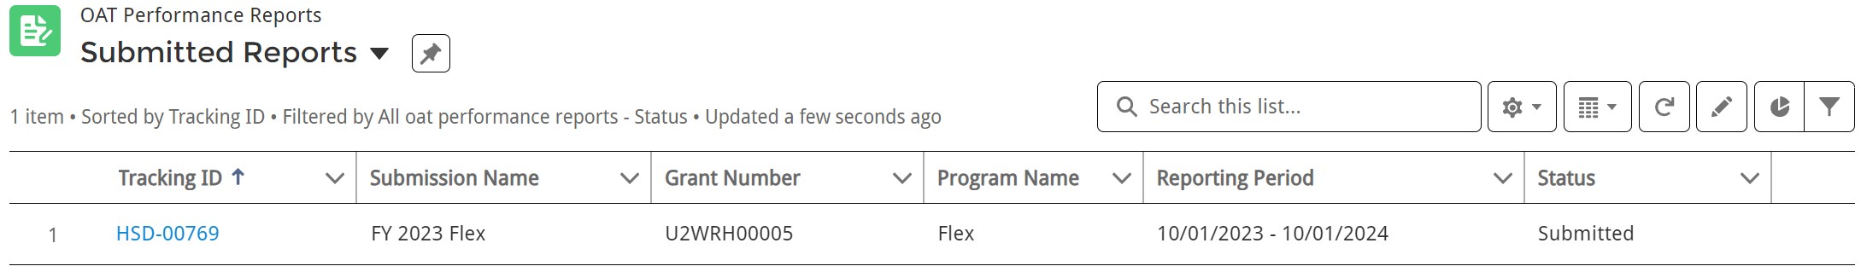
Submit Confirmation and Status
Add optional Comments
Click to Submit for HRSA PO review
After Submitting for Approval…
Performance Report in Submitted status
Notes:
Enter optional comments in the Submit for Review pop up window and click Submit!
Then, your report updates to Submitted status and moves to the Submitted Reports list view.

Slide 20
Approval History and Approved Reports
Notes:
Now, let’s take a look at how to check on the approval status of your report.

Slide 21
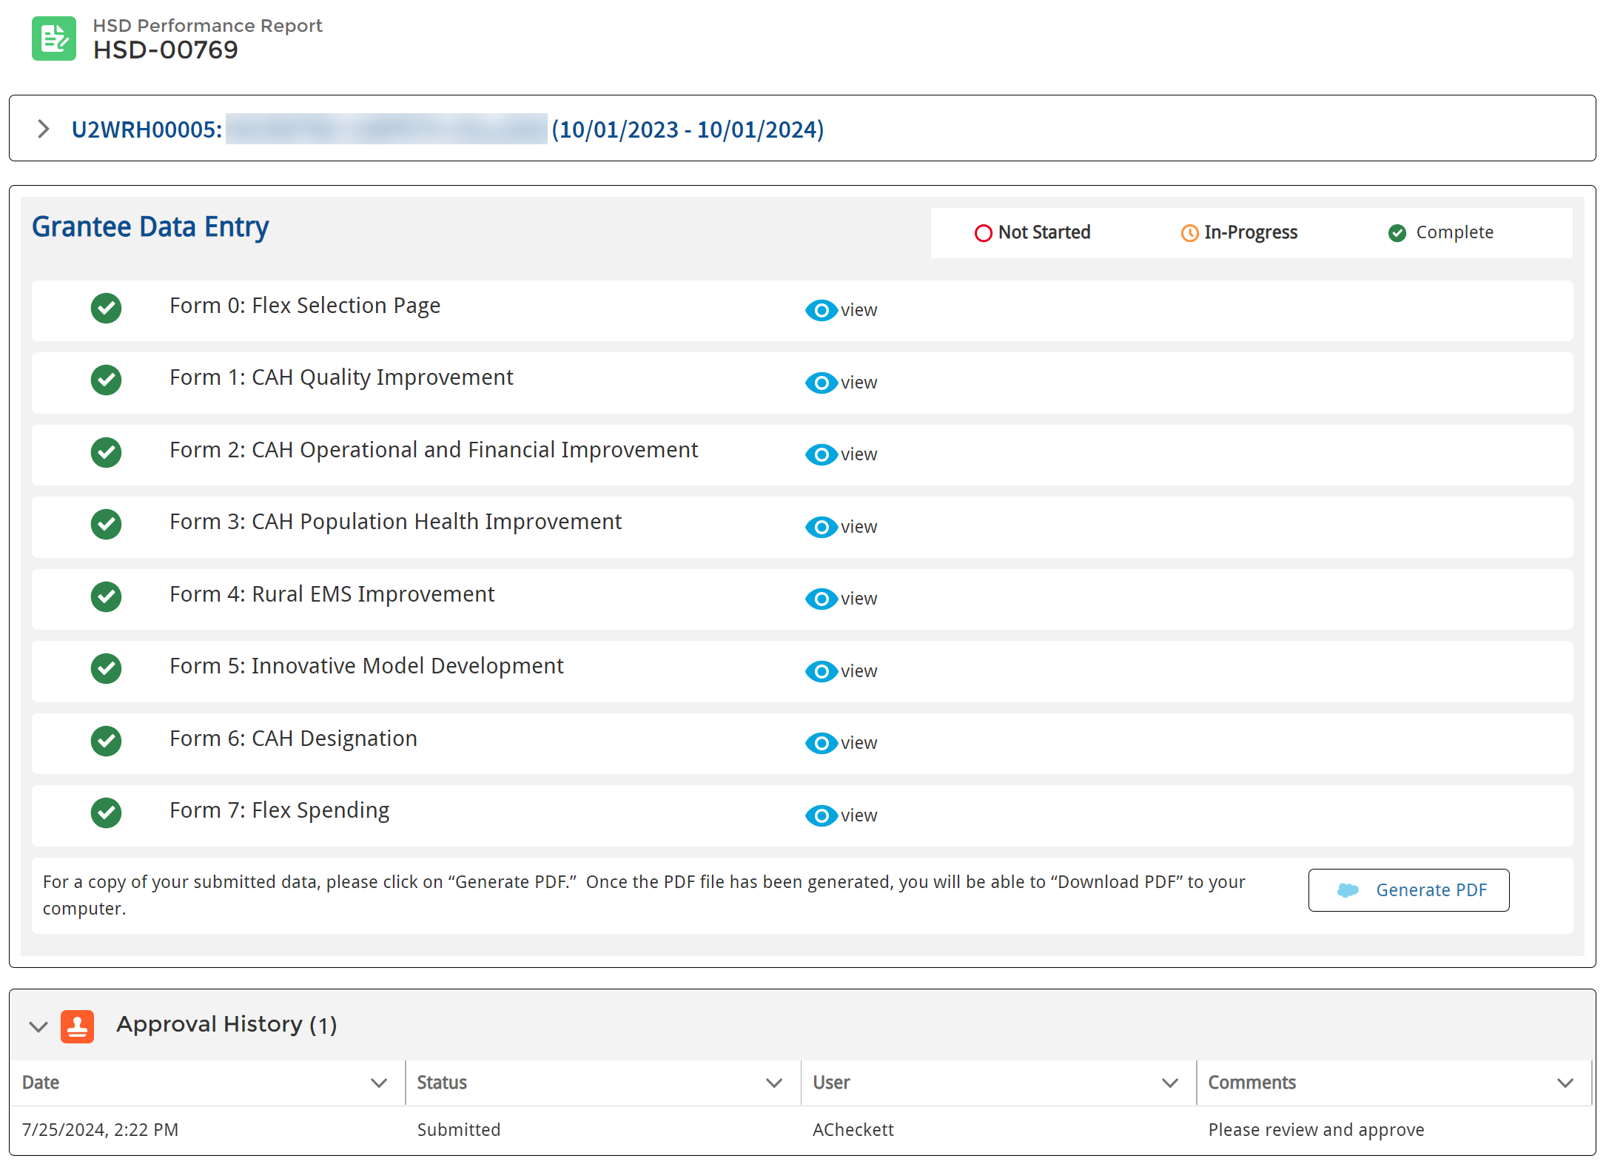
Approval History
Approval History updates as HRSA PO reviews and approves or requests changes
Click to view full comments
Notes:
After submitting your report, you can track the progress through the Approval History section. As the HRSA PO makes decisions, you can see if it was approved or if changes were requested.
You can also see all comments added when the report was submitted, approved, or change requested. On the right side of the screen, click the arrow to view full comments

Slide 22
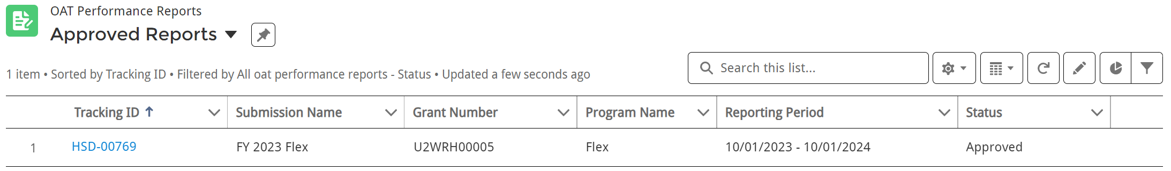
Approved Performance Reports
Click to access read-only view
Approved Status
Notes:
Once approved by HRSA, the performance report status updates to Approved and is listed on the Approved Reports list view.

Slide 23
Change Requests
Notes:
Now, what happens if HRSA requests updates to the report while reviewing? Let’s take a look.

Slide 24
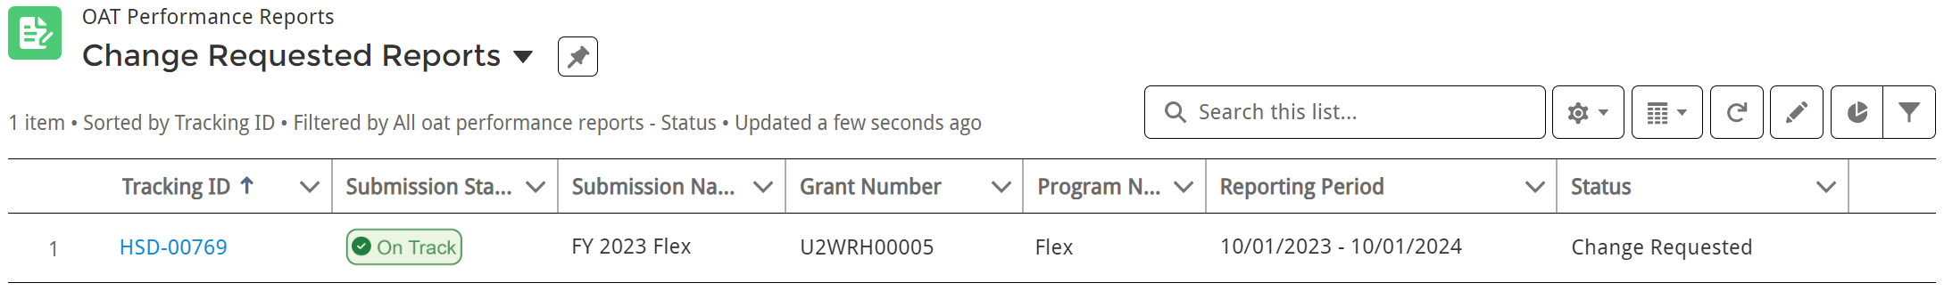
Change Requested Reports
Change Requested Status
Open Performance Report, Update, and Resubmit
Notes:
If HRSA sends back the report for updates, you will receive an email notification with the comments the PO added about the requested change. The performance report status moves to Change Requested and you can find the report on the Change Requested Reports list view.
Click on the Tracking ID to open the report to make changes.

Slide 25
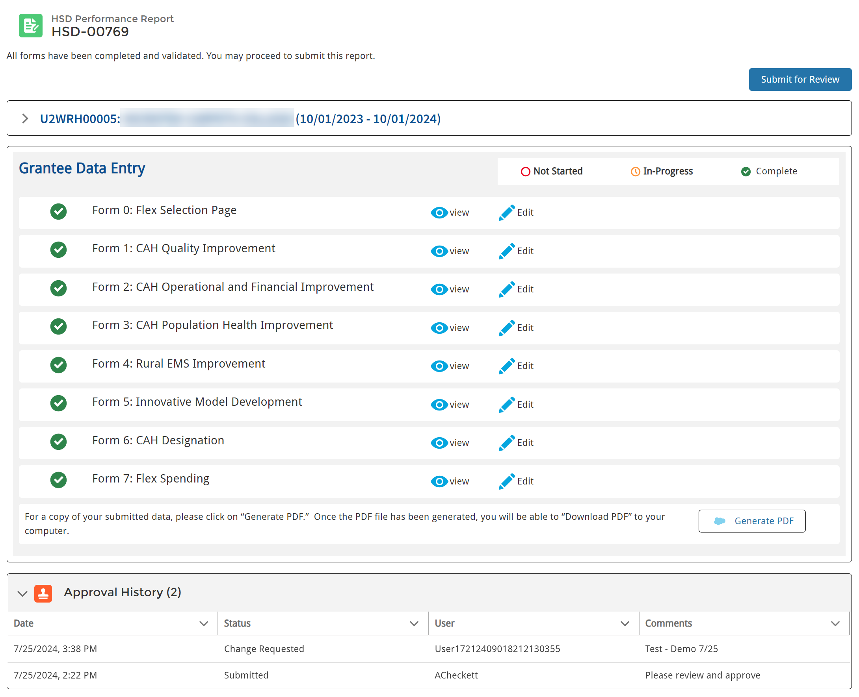
Change Request Comments
Click to view full comments
Notes:
When you open the performance report, in the Approval History section you can see the comments the HRSA PO added about the requested changes. On the right side of the page, click the arrow to view all comments, if they are long.
Then, open your performance report, make changes, and be sure to resubmit. The Edit button will be available after changes are requested.

Slide 26

Demo – Logging in, Homepage, Completing and Submitting Reports
Notes:
Now, let’s walk through the system with a live demo.

Slide 27
Grantee Raw Data Report
Notes:
Now, let’s take a look at your Grantee Raw Data Report.

Slide 28

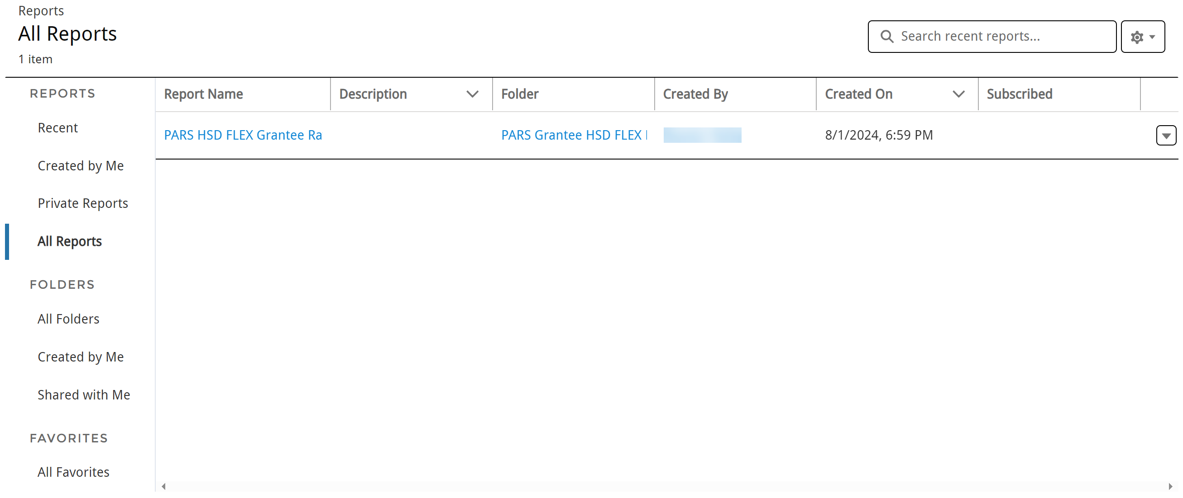
Reports
View Grantee Raw Data Report
Run or Export the report
Open Grantee Raw Data Report
Select to view Reports, Folders, or Favorites
Notes:
To access your Grantee Raw Data Report, select Data Extracts from the top navigation bar or widget on the homepage.
The page defaults to the Recent view, but the first time you open the page there will be nothing listed. Select All Reports from the left menu to view all reports applicable to your role.
Then, select the Grantee Raw Data report to open the report or select Run or Export from the drop-down menu on the right side of the page.

Slide 29
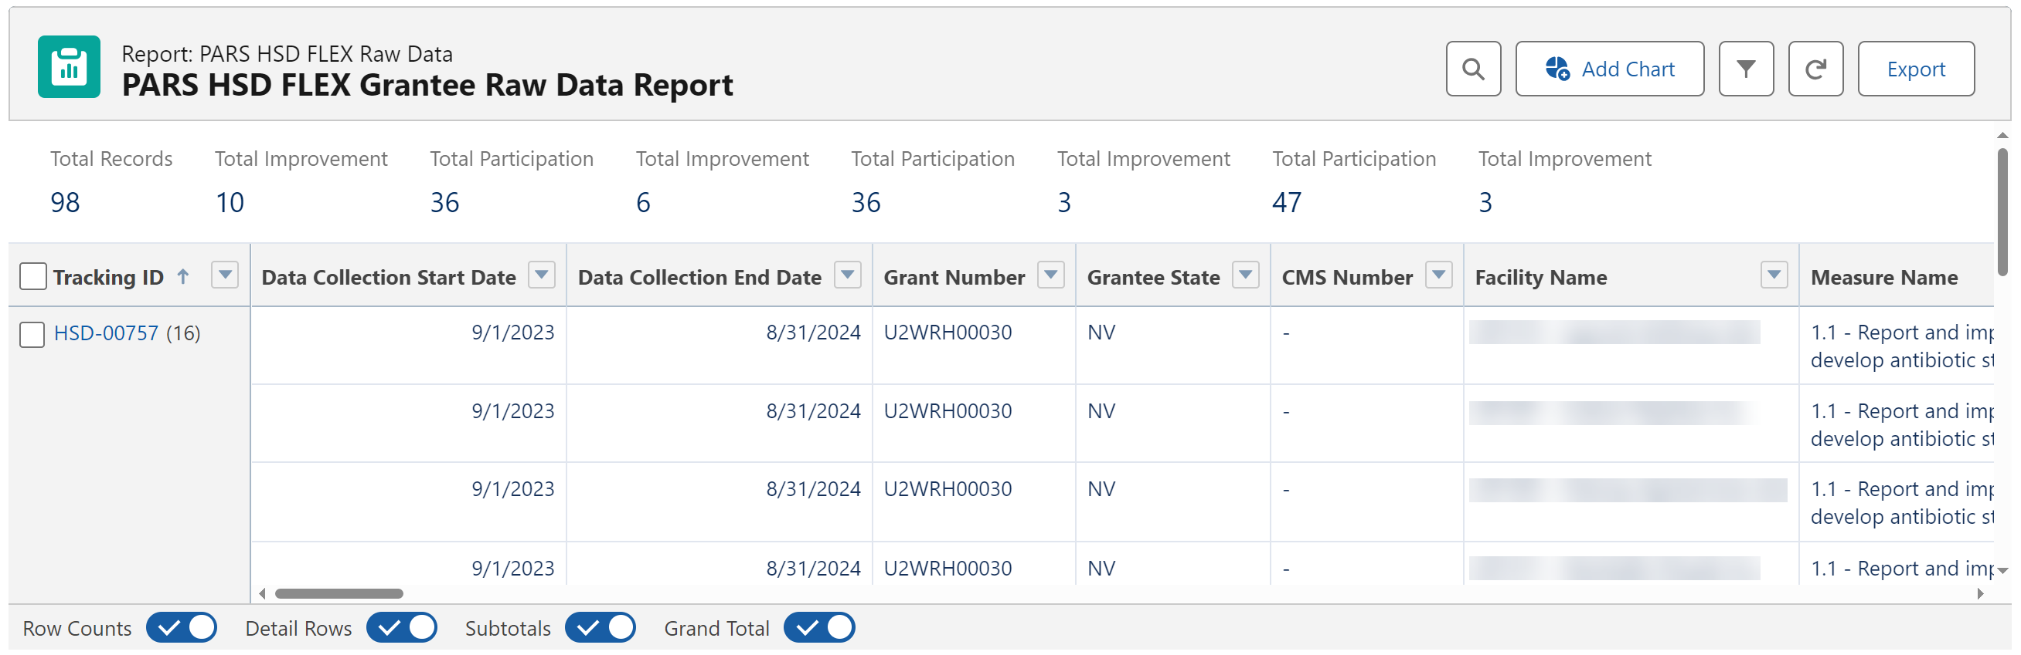
Grantee Raw Data Report Page
Scroll to view data
View Facility details
Notes:
Click on the report name or Run to open the report.
Use the scroll bar on the bottom of the page to view all data on the report.
Select the Facility Name to view the Facility details.

Slide 30
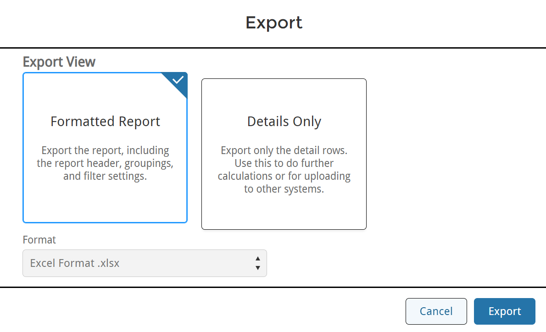
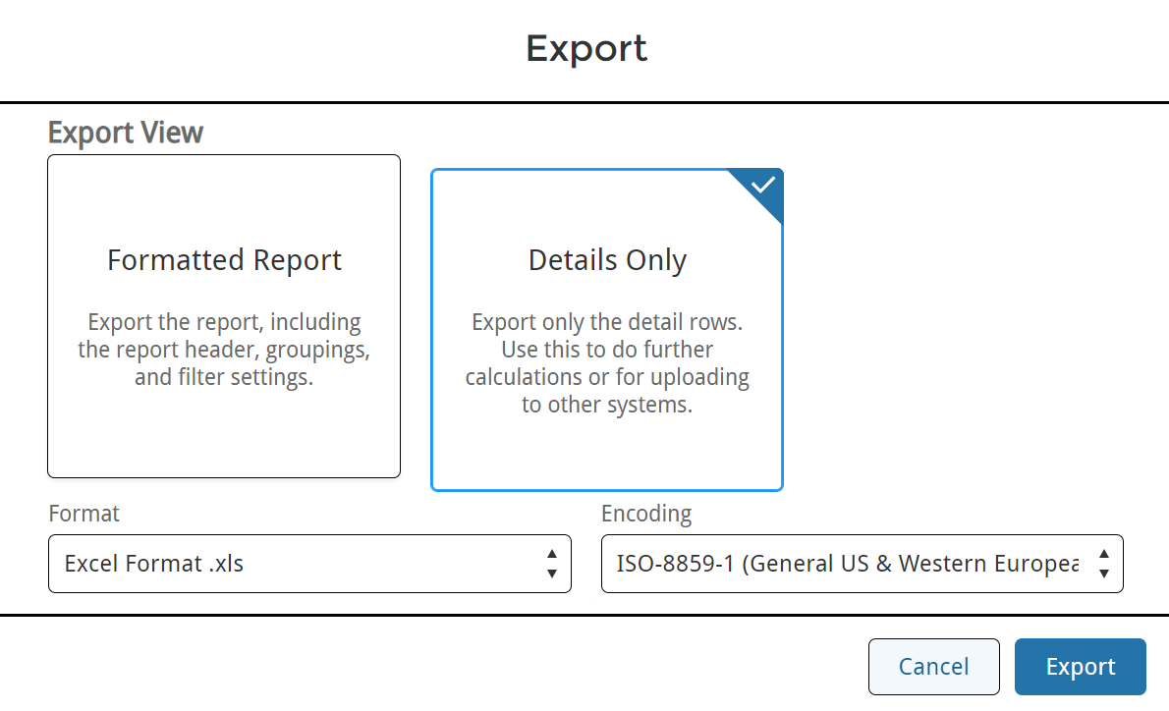
Exporting Reports
Export Formatted Report
Export Details Only Report
Click Export after selecting the format
Click Export after selecting the format
Notes:
From the reports page, select Export to download the report.
You can select Formatted Report or Details only, and then click Export.
For the Details Only view, select the Format and Encoding options and then click Export.

Slide 31
Demo – Grantee Raw Data Report
Notes:
Now, let’s walk through the Grantee Raw Data Report.

Slide 32

Important Reminders!
The data does not autosave. Be sure to click Next on each page to save your work.
The system times out after 15 minutes of inactivity, and you will lose any data not saved.
Required fields are indicated with an asterisk (*).
After submitting the Performance Report, you cannot make edits (unless the HRSA PO requests changes).
After a HRSA PO request changes, you must resubmit the report for the HRSA PO to review again.
Notes:
And that’s it! Let’s go over a few important reminders, and then we’ll get to your questions.
The data does not autosave. Be sure to click Next on each page to save your work.
The system times out after 15 minutes of inactivity, and you will lose any data not saved.
Required fields are indicated with an asterisk.
After submitting the Performance Report, you cannot make edits (unless the PO requests changes).
After a HRSA PO request changes, you must resubmit the report for the PO to review again.

Slide 33
Resources
Step by Step Guides
FAQs
Login.gov Customer Support Team
  Questions related to logging into to HRSA Data Collection Platform
  https://login.gov/contact/
HRSA Customer Support Team
  Questions related to your performance report
  877-464-4772 or https://hrsacm.my.salesforce-sites.com/EHBExternalForm
  HRSA Project Officer (PO)
  Questions about your grant or the data needed for the performance report
Notes:
We also have some helpful resources available to you – you can find step by step guides and FAQs from the Help tab.
If you have questions or issues logging into the system, please contact the Login.gov customer support team
Or if you have questions related to your performance report, please contact the HRSA customer support team or your HRSA PO
You can also reach out to your PO for questions about your grant or the data needed for the performance report

Slide 34

Questions

