Slide 1
Cybersecurity Threats in Rural America How to Protect Your Critical Access Hospitals
Joe Wivoda
CIO & HIT Consultant
September 27, 2016

Slide 2
The Center’s Purpose

Slide 3
Why is this Important?
According to HHS Office of Civil Rights (OCR), as of September 2016:
168,320,984 patient names have been REPORTED to have been breached
126,000,000 of those breaches are reported as having either hacking or other IT issue being a factor
Medical records are incredibly valuable!
Credit Card number: < $5
Social Security Number: <$20
Medical Record: Between $100-$1,300

Slide 4
Overview
Understand the types of cyber threats that exist today
Review the mechanisms that malware commonly use to infect computers
Discuss the consequences of a malware attack
Present some steps that critical access hospitals (CAHs) can take to reduce the risk
Discuss how to respond to a malware incident
Discuss a particular type of malware, “Ransomware” and the unique threat it presents

Slide 5
Threat Landscape
Viruses: Infects files and seeks to replicate itself
Worms: Standalone malware that replicates itself
Trojan Horses: Misleads users of its true intent
Spyware: Tracking software, without consumers knowledge

Slide 6
Threat Landscape
Adware: Software that delivers advertising, often unwanted
Scareware: Malicious software that uses social engineering to scare you into doing something
Ransomware: Software that holds your data hostage, usually with encryption technology

Slide 7
Infection Mechanisms
Media
Floppies, CD-ROM, USB drives, etc.
Network
Poor security on local networks
Open ports and flawed services
Email
Attachments, including .doc and .zip
Embedded HTML
Web browser
Social engineering
Browser flaws
Remote code execution

Slide 8
An Example
Search for information or software in Google
Of the several sites listed, you select one that has been compromised
An ad appears that looks like a legitimate error message
Your files are now being encrypted

Slide 9
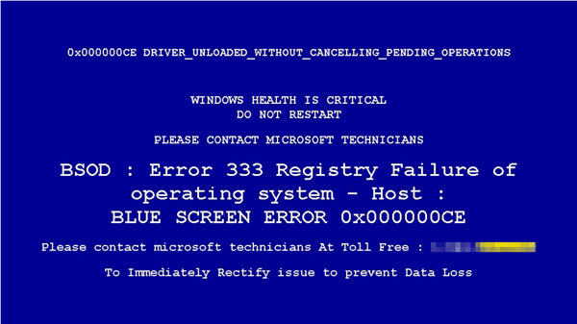
Ransomware Example
From https://www.microsoft.com/en-us/security/portal/mmpc/shared/ransomware.aspx

Slide 10
Consequences
Patient care processes can be disrupted
Hospitals have gone on divert
Business process can be disrupted
Months of backlogged bills
Reputation damage
Particularly if there is a reportable breach
Patient data loss
Identity theft
Unreimbursed medical care
Financial losses for patients

Slide 11
When has a Breach Occurred?
ANY malware event is a security incident and requires an incident response
Determination of the likelihood of whether protected health information (PHI) was acquired by the attacker
Malicious encryption is assumed to mean the data was acquired
This incident response and investigation is key to breach determination
May require third-party experts

Slide 12
Steps CAHs Should Take
Have good HIPAA policies and practices
Risk assessment
Incident response
System monitoring
Backups, backups, backups!
Good backups are fundamental
Need to be verified
Offsite storage, but be careful about security

Slide 13
Steps CAHs Should Take
Install and maintain anti-malware software
Centrally managed is best
Include Windows Servers, but work with your electronic health record (EHR) vendor
Keep Windows and browser software up to date
Sound firewall practices
Have good downtime procedures and test them
Train staff on smart browsing!
These are all fundamental IT responsibilities that can be a luxury for small IT departments!

Slide 14
The CAH Dilemma
Complex IT systems
50-200 computers
Limited IT staff
Massive vulnerability to malware!
Need to rely on quality third party vendors
Antivirus
Backups
Firewall
PC management

Slide 15
How to React to a Cyber Event
Before you can react, you need to be able to identify that there was an event!
System monitoring
Notifications from antivirus software
Firewall notifications
End-user notification
Assemble the right team, quickly
May require outside expertise
If it is a propagating malware (virus, worm, etc.) then consider ways to stop the propagation

Slide 16
How to React to a Cyber Event
Gather as much information as possible
Log files and backups need to be preserved
Determine whether PHI was acquired
How many patient records?
What specific information?
If the event is ransomware, then notification of law enforcement, local and FBI, as well as OCR is recommended
See CMS Fact Sheet: Ransomware and HIPAA: https://www.hhs.gov/sites/default/files/RansomwareFactSheet.pdf

Slide 17
Do You Pay or Not?
Even if you pay, there is no guarantee that you will get the data back
You are still required to follow breach notification rule
Restore of files could take a significantly long time, depending on the size of the data
In many cases the payment is much less than the cost of lost revenue and possible patient safety concerns

Slide 18
Summary
Malware will continue to be a threat
Protecting your facility requires more than good antivirus software
Good IT practices, including well-tested backups, antivirus software, firewalls, and system monitoring are critical
End-user training can prevent most malware from spreading
Most CAHs will need help from outside vendors that do not need to be local

Slide 19
Joe Wivoda
CIO & HIT Consultant
(218) 262-9100
jwivoda@ruralcenter.org

