Slide 1
Fundamentals of Rural Health Clinics (RHCs)
Nathan Baugh
(202) 543-0348
Nathan.Baugh@narhc.org
www.narhc.org

Slide 2
Overview
Purpose of RHC Program
History of RHC Program
Basics of RHCs
Regulatory Update
Legislative Update

Slide 3
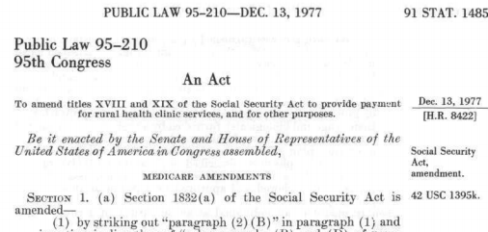
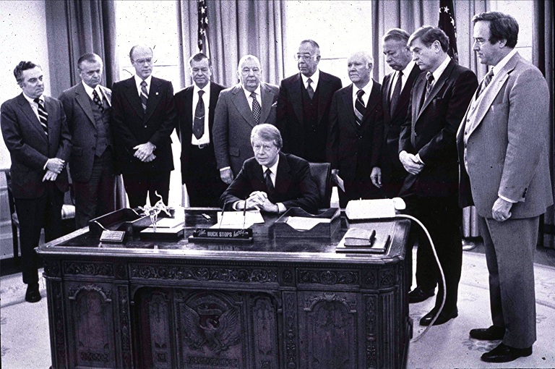
Rural Health Clinic Services Act ~ 1977

Slide 4
Rural Health Clinic ~ Purpose?
President Carter’s Statement on December 13, 1977 signing the Rural Health Clinics Services Act into law:
“At its best the American health care system is unsurpassed. But its uneven distribution leaves millions of our people without access to adequate care. This problem effects both urban and rural areas but is more wide-spread in the latter. Two thirds of the people in areas without adequate health care live in rural America. One of the most sensible and efficient ways to cope with this problem is to enable Physician Assistants and Nurse Practitioners to provide regular and high quality care in small convenient outpatient clinics. Through such programs as the National Health Service Corps and the Appalachian Regional Commission, the federal government has helped to start and support these clinics and train the highly skilled professions who operate them. But there has been a major obstacle to the healthy growth of these clinics in the areas that need them. That is the failure of public and private health insurance programs to support them. The legislation that I am signing today will correct this defect in our public health insurance programs by requiring that the Medicare and Medicaid programs pay for the services of Physician Assistants and Nurse Practitioners in clinics and rural areas without adequate care. This reform will guarantee greater financial stability for clinics already in existence and help establish new clinics were they are needed most.“

Slide 5
Rural Health Clinics ~ Brief History & Profile
Relatively sleepy program throughout the early 80s.
Significant growth in the number of RHCs when hospital payment switched to the prospective payment system (PPS)
Turmoil in the late 90s
Currently over 4400 RHCs in the country (program is growing)
Challenges Remain

Slide 6
RHC Basics ~ Requirements
Located in rural areas
Located in shortage areas
Must undergo a survey and certification process to ensure compliance with 42 Code of Federal Regulations (CFR) Part 491
Must perform primarily “primary care” services
Must employ and utilize a Nurse Practitioner or Physician Assistant at least 50% of the time the RHC is open
Can be non-profit or for-profit
May be owned by hospital or physicians themselves

Slide 7
RHC Basics ~ Incentives
Cost-based reimbursement
Medicare All-Inclusive Rate
Medicaid “PPS” Floor ~ Actual payments vary by state but are generally much better than fee for service (FFS) Medicaid payments
All-Inclusive Rate = Same Medicare payment no matter what current procedural terminology (CPT) code is billed throughout the course of a year
NOT Fee-for-service! Medicare Access and CHIP Reauthorization Act of 2015 (MACRA)/Quality Payment Program (QPP) implications
RHCs file cost reports which (theoretically) allows RHCs to receive 100% of the costs of providing care to Medicare patients

Slide 8
RHC Cap ~ Medicare Payment
(f) In establishing limits under subsection (a) on payment for rural health clinic services provided by rural health clinics (other than such clinics in hospitals with less than 50 beds), the Secretary shall establish such limit, for services provided—
(1) in 1988, after March 31, at $46 per visit, and
(2) in a subsequent year, at the limit established under this subsection for the previous year increased by the percentage increase in the Medicare economic index (MEI) (as defined in section 1842(i)(3)) applicable to primary care services (as defined in section 1842(i)(4)) furnished as of the first day of that year.
The RHC Cap for 2018 was $83.45

Slide 9
Questions?

Slide 10
2019 Physician Fee Schedule (PFS) Proposed Rule – Chronic Care Management (CCM) Provisions
Proposed payment methodology for Healthcare Common Procedure Coding System (HCPCS) code G0511 would be the average of the 4 national non-facility PFS payment rates for
-CPT 99490 (20 minutes or more of CCM services)
-CPT 99487 (60 minutes or more of complex CCM services)
-CPT 99484 (20 minutes or more of BHI services)
-CPT 99491 (30 minutes or more of CCM furnished by a physician or other qualified health care professional)
Proposed payment rate for 99491 is $74.26
Average of the four is around $65

Slide 11
2019 Physician Fee Schedule – Communication Technology-Based Services
At least 5 minutes of communications technology-based or remote evaluation services
Furnished by an RHC practitioner
To a patient that has been seen in the RHC within the previous year
May be billed when the medical discussion or remote evaluation is for a condition not related to an RHC service provided within the previous 7 days, and
Does not lead to an RHC service within the next 24 hours or at the soonest available appointment (since in those situations the services are already paid as part of the RHC all inclusive rate (AIR))

Slide 12
Proposed Billing and Payment for Communication Technology-Based Services
New Virtual Communications G code for use by RHCs (and federally qualified healthcare centers (FQHCs)) only
G0071
Payment rate set at the average of the PFS national non-facility payment rates for HCPCS code G2012 (communication technology-based services) and HCPCS code G2010 (remote evaluation services)
Payment around $14
Many of the details will need to be worked out in final rule and accompanying guidance from Centers for Medicare and Medicaid (CMS)

Slide 13
Legislative Update ~ Senate Finance Hearing
https://www.finance.senate.gov/hearings/rural-health-care-in-america-challenges-and-opportunities
2 hour 28 min mark
Senator Wyden
“We have been at it for almost two and a half hours. You all have been terrific, but what I am struck by is I don’t think we have mentioned, over the course of two and a half hours, what is really the backbone of rural health care. Literally, from sea-to-shining-sea, and that is RURAL HEALTH CLINICS…”

Slide 14
.

Slide 15
RHC Modernization Act of 2018 – What does it do?
Designed to pass, not to make a statement
Uncontroversial and cost free provisions
Sec. 2 ~ Modernizing Physician, Physician Assistant, and Nurse Practitioner Utilization Requirements.
Modernizes physician supervision requirements in RHCs by aligning scope of practice laws with state law. Allows physician assistants (PAs) and nurse practitioners (NPs) to practice up to the top of their license without unnecessary federal supervision requirements that apply only because the PA or NP is practicing in a RHC.
Sec. 3 ~ Removing Outdated Laboratory Requirements
Removes a requirement that RHCs maintain certain lab equipment on site, and allows RHCs to satisfy this certification requirement if they have prompt access to lab services.
Sec. 4 ~ Allowing Rural Health Clinics to Determine the Drugs and Biologicals Necessary for Emergency Cases.
Allows the professional personnel responsible for the RHCs policies and procedures, instead of the Secretary of Health and Humans Services, to determine the drugs and biologicals necessary for emergency cases in each specific RHC.
Sec. 5 ~ Allowing Rural Health Clinics the Flexibility to Contract with Physician Assistants and Nurse Practitioners.
Removes a redundant requirement that RHCs employ a PA or NP (as evidenced by a W2) and allows RHCs to satisfy the PA, NP, or Certified Nurse Midwife(CNM) utilization requirements through a contractual agreement if they chose to do so.

Slide 16
RHC Modernization Act of 2018 – What does it do? Continued
Cost Provisions
Sec. 6 ~ Raising the Cap on Rural Health Clinic Payments.
Increases the upper limit (or cap) on RHC reimbursement to:
-$100 in 2019
-$105 in 2020
-$110 in 2021
-$115 in 2022
-And by MEI each year thereafter.
Sec. 7 ~ Allowing Rural Health Clinics to be the Distant Site for a Telehealth Visit.
Allows RHCs to offer telehealth services as the distant site (where the provider is located) and bill for such telehealth services as RHC visits.

Slide 17
Any Questions?

Slide 18
Contact Information
Nathan Baugh
(202) 543-0348
Nathan.Baugh@narhc.org
www.narhc.org

