Slide 1
Strategic Planning Presentation Template Rural Health Network
Facilitator Name
Job Title
Date
Notes:
How to use this Strategic Planning Event sample presentation – approximately a 60 – 90 minute presentation including discussion
Purpose of this Guide
This Program Strategic Plan sample presentation is designed to provide support to Network Development grantees to create an effective and participative strategic planning event with the result of having consensus of strategic objectives to guide the network over the coming 2-3 years.
This presentation includes slides that provide strategic planning process description along with a suggested layout and order of the network organization’s mission, values, vision, environmental information at the national, regional, and network levels, and guidance on components of a strategic planning event.
Rural Health Innovations (RHI), LLC is a subsidiary of the National Rural Health Resource Center (The Center), a non-profit organization. Together, RHI and The Center are the nation’s leading technical assistance and knowledge centers in rural health. In partnership with The Center, RHI enhances the health of rural communities by providing products and services with a focus on excellence and innovation. RHI is providing technical assistance (TA) to the Network Development grantees through a contract with the Federal Office of Rural Health Policy.

Slide 2
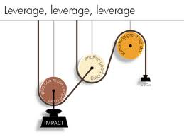
Strategic Planning
“It is not enough to just do your best or work hard. You must know what to work on.”
– Edward Deming
Notes:
10 min
Introduce participants
We are here today and tomorrow to get some good planning work for [Rural Health Network]. We will be considering our organization and the environment that [Rural Health Network] works within. I would like to emphasize Edward Deming’s remark – “it is not enough to just do your best or work hard. You must know what to work on”. Deming is a quality improvement thinker from the 50’s, 60’s that helped transform the Japanese economy with the idea that measuring and making adjustments based on the results was a good thing to do – it allowed the system to know what to work on. We are going to be walking on this path with Deming today; getting started looking for leverage points and identifying barriers that we need to work around or to change in order to move the organization forward.

Slide 3
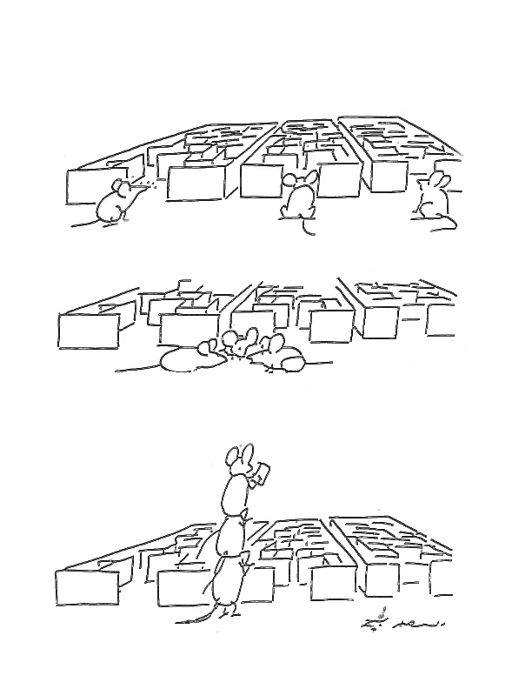
A Collaborative Effort
Notes:
1 Min
This slide is one we use to remind ourselves that working together is a good idea for coming up with solutions to complex issues, for bringing stronger voices to the forefront of discussion and decision making, and for leveraging the strengths of diversity. Today with you planning work you will consider what collaborative paths you will be taking over the coming months to get through the maze of your network’s future.

Slide 4
Agenda
Morning: 8:30 a.m. – 12:30 p.m.
Strategic Planning – Part I
Environmental Data
Levers and Blocks Analysis
Vision Discussion
Afternoon 1:00 – 4:00 p.m.
Strategic Planning – Part II
Strategic Objectives Workshop
Alignment with Mission, Vision and Studer
Notes:
2 min
We will spend time getting started today considering what is strategic planning so that we are all comfortable with the work we are going to be doing and to be clear on the outcomes for your hospital and clinic.
We will spend the first half of the planning ‘priming the pump’ for really good strategic thinking in the second half. In the strategic objective workshop setting you will have opportunity to do some individual thinking, we will work in pairs to share our thoughts and then as a large group come to consensus on strategic objectives for the [Rural Health Network]. At the end of the planning we will check back to your organizations mission and vision and consider next steps.

Slide 5
Working Together
Ground Rules
Notes:
3 min
Experience and Expectation Check in
Focus Conversation:
Before we agree on some ground rules for today, let’s check-in with each other on today’s expectations and strategic planning experience..
How many of you have been involved in strategic planning? …With other organizations? Other kinds of planning work?
On a scale of 1/10 how happy are you all about doing this planning work today?
And what is your expectations or hopes for todays and tomorrow mornings efforts?
What are the ground rules we are going to work within today? (record on flip chart paper and post up front or near front to the side)
What do we agree on for our behaviors during the planning session that will make this planning session the best it can be? (prompt – no cell phones, email, work) and (listen, be open, direct, honest)… facilitators rules: be careful of the time and check in with the group with any process questions, give permission to be comfortable, have some fun.

Slide 6
Why do Strategic Planning?
The best way to predict your future is to create it.
-Peter F. Drucker
Notes:
1 min
Peter Drucker is a management thinker from the 50’s and 60’s. He is credited with coining the term ‘ knowledge worker’.
The reason we are here today is for you all to participate in creating the future of the organization.
NOTE:
Drucker – management expert, NYU, 1950-1971
Wikipedia Introduction: He is one of the best-known and most widely influential thinkers and writers on the subject of management theory and practice. His writings have predicted many of the major developments of the late twentieth century, including privatization and decentralization; the rise of Japan to economic world power; the decisive importance of marketing; and the emergence of the information society with its necessity of lifelong learning.[3] In 1959, Drucker coined the term “knowledge worker" and later in his life considered knowledge worker productivity to be the next frontier of management.

Slide 7
Planning Methodology
Notes:
3 -5 Min
Introduce planning methodology:
Robert Kaplan and David Norton, writers/thinkers of Balanced Scorecard, out of Harvard in 1980’s. Studied organizations to figure out why some succeed and others don’t‘. Discovered that those succeeding had a holistic way of approaching their organizations. In this they identified four ‘perspectives’ that helped the organization look at the whole company: financial, customers, internal processes, culture, people, tools
Use a baseball game metaphor to differentiate between Mission Values and Vision:
Mission (what we do) = play baseball
Values (how we do it)= play fair and play hard
Vision (what we want to achieve or become) = entertain the fans, have the biggest trophy ever, be the envy of all other baseball teams
Strategy = our game plan
Business – sell tickets to our games
Customers – entertain – so be athletic and have some showmanship
Internal process – know the plays and tactics and be very effective at implementation
Learning/growth - be smart players, be a supportive / positive team, have the tools we need to train
(10 min total) Using Small Groups – have them brainstorm answers to these questions (5 min) and report back to large group for discussion (5 min)
Wont’ win though until the whole team knows what the mission , values, vision, and strategies are so…
Communicate and Operationalize w/ practice
Won’t win though until we know what we want to improve
Quality Management includes choosing the measurements that make sense to see if we are making a difference in our strategies –
Business – ticket sales in numbers and dollars
Customers – customer enthusiasm scores, number of fans in bad weather, number at away games
Internal process – player errors, homeruns, sprint times, % catches and outs
Learning/growth – player outlook on team future scores, number of returning players, …?
Won’t win until we are actually measuring and monitoring our progress and check in with results in order to make changes and adaptations

Slide 8
Network Mission
[insert Network’s mission]
Notes:
1 min
Read through

Slide 9
Network Values
[insert Network’s values]
Notes:
1 min
Read through

Slide 10
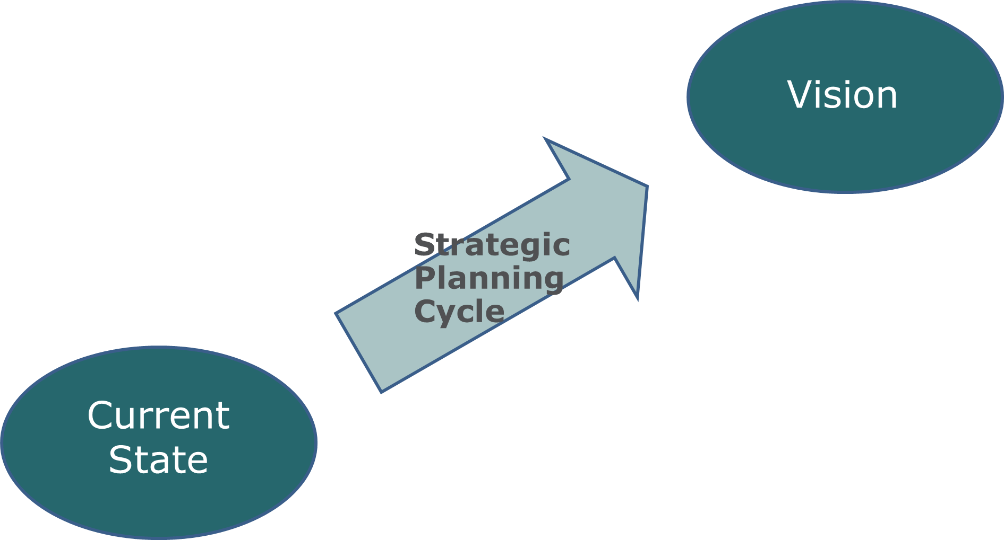
Aiming for the Vision
Adapted “Creative Tension” model by Peter Senge, et. al.
Notes:
1 min
Highlight and emphasize the dynamic and iterative nature of strategic planning. It is indeed a cycle and with every cycle the current state changes position relative to the vision… as we make progress toward the vision and time ‘happens’ our current reality changes . We use our strategies to stay on the path but need to monitor and adjust as we go.. The vision is so we don’t loose the way and we have something to aim for.
NOTE: Peter Michael Senge (born 1947) is an American scientist and director of the Center for Organizational Learning at the MIT Sloan School of Management. Senge emerged in the 1990s as a major figure in organizational development with his book The Fifth Discipline where he developed the notion of a learning organization. This views organizations as dynamical systems (as defined in Systemic) in a state of continuous adaptation and improvement.
through

Slide 11
Network Vision Check-In and Commitment
[insert Network’s vision]
Notes:
10-15 min
“Our Network vision … read through… is one that has already been approved by the governing board. In this time of planning and careful consideration and due to the importance of having a vision that we all agree to aim for during the planning and over the course of implementing our plans in the coming 2-3 years; let’s spend about 10-15 minutes talking about what this vision means for our network and to us.”
Focused Conversation
what specific word in this vision catches your attention ?
what about this vision resonates with you? How does it hold your attention?
how does this vision describe what we want to become as a network in this region and for our members?
what might be the impact be on your communities as [Rural Health Network] strives to become what is stated here?
s this vision one we are all comfortable using as a beacon for our strategic planning?
if not: what can we adjust to make it right for us today?
Note: if the vision is close but the discussion identifies that there are needed revisions and input; consider getting a group consensus that it is close enough for planning and that a vision review will take place in the near future. Set a timeline and ask an individual to take the lead on next steps
Do not proceed with planning until all participants are in consensus that the vision is worthy as a target for strategic planning. T
o make sure all participants are ready to move forward with the vision for strategic planning: use a method of gaining commitment with the vision – thumbs-up (agree), flat (can live with), or Thumbs-down (can’t live with it and need additional discussion)

Slide 12
Strategic Cycle: Begin with Analyze and Plan
Notes:
3 min
In this dynamic and iterative environment of strategic planning there is a cycle. Today we are in the analyze and plan phase. When we are done then your organization will move to another phase – document and communicate.
I also want to highlight different roles you all will play within this cycle. It is the job of the board to set the vision and identify the strategic paths and you have a role of communication. It is the job of the organization leadership and staff though to continue to move through the cycle through implementation and execution, monitoring and adapting. So together you are setting the place to aim for, the vision and will be defining the paths for getting there and then it will be the leadership and staffs job to make it happen.

Slide 13
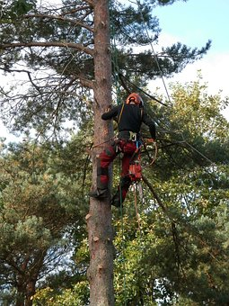
What is the Value of Strategy?
Notes:
3 min
Strategy is about getting the overview/perspective, and determining what actions that will bring you closer to your goal.
Tell story of loggers climbing a tree to find the ‘strategic’ log to pull from the jam.
This picture comes with a story. Many immigrants came to this country looking for work. Some of them came to places where there was an abundance of timber and became lumberjacks. The object of this work was to cut down the trees and get them to a river where the logs could float downstream to the mill. Normally, things went along smoothly but occasionally, a log jam developed. This was the point at which it was easy to distinguish the seasoned and wise fellows from the “newbies.” The newbies would become aware of the problem and run to the river. Once there, they would start taking logs out of the river until the jam was cleared and the flow started again. It was exhausting, demanding work.
The seasoned lumberjacks, on the other hand, would become aware of the problem and (instead of going to the river) would immediately climb a tree. From this vantage point, they could pinpoint which log was causing the jam. They then climbed back down and removed the one or two logs that were holding up the process, and the flow was restored.
How does this relate to strategic thinking? Ask participants and be ready to add the following points:
It is useful to remove yourself from the day-to-day in order to get perspective on patterns and key drivers that influence your ability to succeed.
Strategy helps you focus efforts on important things--after all, no one has excess time or money? We can’t do everything at once, nor should we.

Slide 14
Analyze and Phase Plan
Consider the environmental factors and look for:
Symptoms of change
Root causes of change
Notes:
1 min
While in the environmental scan portion of the data we will be looking for and considering…
Where are the logs that need to be pulled out of the jam?
Are we looking ahead at what might happen to avoid be crushed by our decisions? Are there cause-and-effect relationships between the factors? What factors are root causes and what factors are symptoms?

Slide 15
National Health Care Update
Better care
Better health
Lower cost
Notes:
3-5 min (national Triple Aim presented in slide)
Present and discuss what is happening in health care at the national level
Focused Conversation:
What are you experiencing in your organization due to the changes in health care?
What are the opportunities that may develop for our members?
What are the challenges our members are experiencing?
How might the network be impacted by these national changes or trends?

Slide 16
What is happening in our region or state?
Consider participation in an ACO, a medical home or other value-based models
Partner with local primary care physicians
Care coordination initiatives
Prepare for population health management
Notes:
3-5 min (examples included in slide)
Present and discuss what is happening in health care in the region and the state:
Focused Conversation:
What are you experiencing in your organization due to the changes in health care?
What are the opportunities that may develop for our members?
What are the challenges our members are experiencing?
How might the network be impacted by these national changes or trends?

Slide 17
‘State of the Network’ Report
[insert and present findings or progress updates]
Notes:
2-5 min
Network Director presents findings or progress updates

Slide 18
Network Members
[insert and present members’ names]
Notes:
1 min
Network Director presents members

Slide 19
Network Governance
[insert governance highlights to be presented by Network Director]
Notes:
1 min
Network Director talks about governance

Slide 20
Current Network Services and Value
[insert and present current listing services]
Notes:
1 min
Network Director presents current services

Slide 21
Network Financial Update
[insert highlights of finances to be presented by the Network Director]
Notes:
1 min
Network Director presents Financial update

Slide 22
Network Program and Initiative Update
[insert and present programs and initiative update by the Network Director]
Notes:
1 min
Network Director presents programs and initiative update

Slide 23
Network Environmental Data: Demographics
[present environmental data – secondary data analysis such as demographic income, education, population (aging) ]
Notes:
1-3 mins
Present environmental data – secondary data analysis
Demographics Income,
education,
population (aging)
US Census Bureau, and Bureau of Labor Statistics

Slide 24
Network Environmental Data: Health Factors
[insert and present environmental data – secondary data analysis such as behavioral health factors, public health issues, and community health profile by county ]
Notes:
1-3 mins
Present environmental data – secondary data analysis
Behavioral health factors,
public health issues,
Community Health profile by county.
County Health Rankings

Slide 25
Network Member Input: Network Strength/Gap
[key informant or interview data of members and partners and community members can be very helpful for gathering insights on the networks’ strengths and gaps as an organization; insert key informant interview summaries and focus groups by describing methodology and providing summary results ]
Notes:
1-3 mins
Key Informant or Interview data of members and partners and community members can be very helpful for gathering insights on the networks strengths and gaps as an organization.
Key informant interview summaries and Focus Groups
Describe methodology
Provide summary results

Slide 26
Network Member Input: Member Needs and Network Opportunity
[key informant or interview data of members and partners and community members can be very helpful for gathering insights on the networks’ strengths and gaps as an organization; insert key informant interview summaries and focus groups by describing methodology and providing summary results]
Notes:
1-3 mins
Key Informant or Interview data of members and partners and community members can be very helpful for an initial and current ‘member needs assessment’ and identifying network opportunities for providing value to members.
Key informant interview summaries and Focus Groups
Describe methodology
Provide summary results

Slide 27
What to work on?
“It is not enough to just do your best or work hard. You must know what to work on.”
-Edward Deming
Notes:
1 min
Transition to next step…we need to “know what to work on” with the presentation of environmental data the next step is to carefully consider this information and identify together the levers that will help us move toward the vision and the blocks that will get in our way. This will help us know what to work on.
NOTE:
William Edwards Deming (October 20, 1900 – December 20, 1993) was an American statistician, professor, author, lecturer and consultant. He is perhaps best known for his work in Japan. There, from 1950 onward, he taught top management how to improve design (and thus service), product quality, testing, and sales (the last through global markets)[1] through various methods, including the application of statistical methods.
Deming made a significant contribution to Japan's later reputation for innovative high-quality products and its economic power. He is regarded as having had more impact upon Japanese manufacturing and business than any other individual not of Japanese heritage. Despite being considered something of a hero in Japan, he was only just beginning to win widespread recognition in the U.S. at the time of his death.[2] President Reagan awarded the National Medal of Technology to Deming in 1987. He received in 1988 the Distinguished Career in Science award from the National Academy of Sciences.

Slide 28
What’s Next for Planning?
Levers and Blocks Workshop: looking at the log jam from the top of the tree
Strategic Objectives Workshop: together finding the paths that will move us toward our vision
Notes:
1 min
After we spend time talking through the levers and blocks, we will put on our strategic thinking hats and work to find those paths toward our vision.

Slide 29
BREAK
Notes:
10 mins
break before Levers and Blocks Analysis workshop

Slide 30
Contact Information
Facilitator's Full Name
Title
Phone Number
Email
Notes:
Fill in your information

